Slide 1
Spring JDBC Support
Internal Use - Confidential

Slide 2
Chapter 6: Spring JDBC Support

Slide 3
Overview
By now you have seen how easy it is to build a fully Spring-managed application. You have a solid understanding of bean configuration and aspect-oriented programming (AOP). However, one part of the puzzle is missing: how do you get the data that drives the application?
Apart from simple throwaway command-line utilities, almost every application needs to persist data to some sort of data store. The most usual and convenient data store is a relational database.
The most notable open source relational databases are perhaps MySQL (www.mysql.com) and PostgreSQL (www.postgresql.org). MySQL is generally more widely used for web application development, especially on the Linux platform. On the other side, PostgreSQL is friendlier to Oracle developers, because its procedural language, PL/pgSQL, is very close to Oracle's PL/SQL language.
Even if you choose the fastest and most reliable database, you cannot afford to lose its speed and flexibility by using a poorly designed and implemented data access layer. Applications tend to use the data access layer very frequently; thus, any unnecessary bottlenecks in the data access code impact the entire application, no matter how well designed it is.
In this chapter, we show you how you can use Spring to simplify the implementation of data access code using JDBC. We start by looking at the large and repetitive amount of code you would normally need to write without Spring and then compare it to a class implemented using Spring's data access classes. The result is truly amazing, as Spring allows you to use the full power of human-tuned SQL queries while minimizing the amount of support code you need to implement. Specifically, we discuss the following:

Slide 4
Comparing traditional JDBC code and Spring JDBC support: We explore how Spring simplifies the old-style JDBC code while keeping the same functionality. You will also see how Spring accesses the low-level JDBC API and how this low-level API is mapped into convenient classes such as JdbcTemplate.
Connecting to the database: Even though we do not go into every little detail of database connection management, we do show you the fundamental differences between a simple Connection and a DataSource. Naturally, we discuss how Spring manages the data sources and which data sources you can use in your applications.
Retrieving and mapping the data to Java objects: We show you how to retrieve data and then how to effectively map the selected data to Java objects. You also learn that Spring JDBC is a viable alternative to object-relational mapping (ORM) tools.
Inserting, updating, and deleting data: Finally, we discuss how you can implement the insert, update, and delete operations by using Spring to execute these types of queries.

Slide 5
Introducing Lambda Expressions
The release of Java version 8 brings lambda expression support, among many other features.
Lambda expressions make a great replacement for anonymous inner class usage and an ideal candidate for working with Spring's JDBC support.
The usage of lambda expressions requires the use of Java 8.
Given that, the chapter code samples and source code download show both flavors where applicable.
Lambda expressions are suitable in most places of the Spring API where templates or callbacks are used, not just limited to JDBC.
Please refer to the Java Lambda Expressions tutorial at http://docs.oracle.com/javase/tutorial/java/javaOO/lambdaexpressions.html for more information.

Slide 6
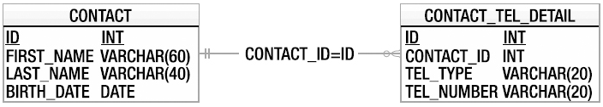
Sample Data Model for Example Code
Before proceeding with the discussion, we would like to introduce a simple data model that is used for the examples throughout this chapter, as well as the next few chapters when discussing other data access techniques (we will expand the model accordingly to fulfill the needs of each topic as we go).
The model is a simple contact database. There are two tables. The first one is the CONTACT table, which stores a contact person's information, and the other table is CONTACT_TEL_DETAIL, which stores the telephone details of a contact. Each contact can have zero or more telephone numbers; in other words, it's a one-to-many relationship between CONTACT and CONTACT_TEL_DETAIL. A contact's information includes their first and last name, date of birth, telephone type, and the corresponding phone number. Figure 6-1 shows the entity-relationship (ER) diagram of the database.
As you can see, both tables have an ID column that will be automatically assigned by the database during insertion. For the CONTACT_TEL_DETAIL table, there is a foreign-key relation to the CONTACT table, which is linked by the column CONTACT_ID with the primary key of the CONTACT table (that is, the ID column).

Slide 7
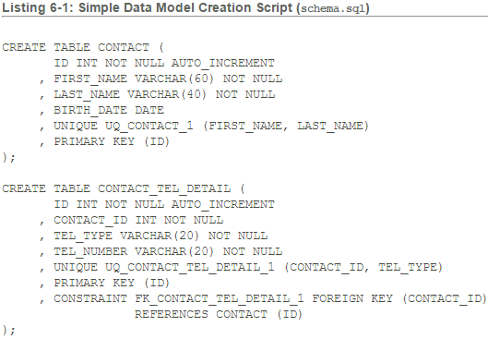

Slide 8
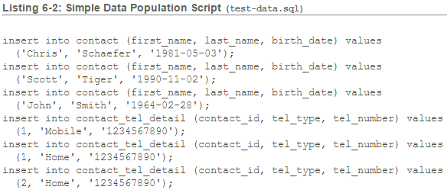

Slide 9
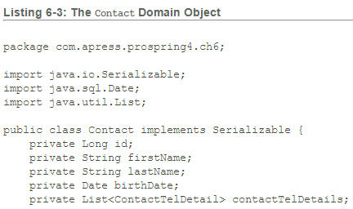
In later sections of this chapter, you will see examples of retrieving the data via JDBC from the database and directly mapping the result set into Java objects (that is, POJOs).
Listings 6-3 and 6-4 show the Contact and ContactTelDetail domain classes, respectively.

Slide 10
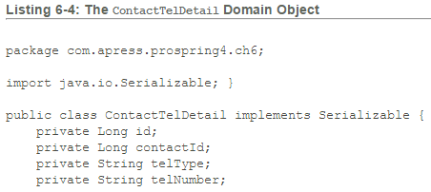
Let's start with a simple interface for ContactDao that encapsulates all the data access services for contact information. Listing 6-5 shows the ContactDao interface.

Slide 11
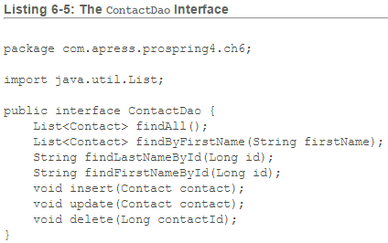

Slide 12
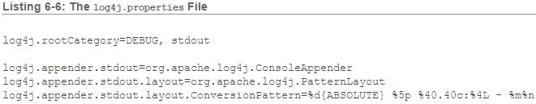
In the previous interface, we define two finder methods and the insert, update, and delete methods, respectively.
They correspond to the CRUD terms (create, read, update, delete).
Finally, to facilitate testing, let's modify the log4j properties to turn the log level to DEBUG for all classes. At the DEBUG level, the Spring JDBC module will output all the underlying SQL statements being fired to the database so you know what exactly is going on; this is especially useful for troubleshooting SQL statement syntax errors. Listing 6-6 shows the log4j.properties file (residing under src/main/resources with the source code files for the Chapter 6 project) with the DEBUG level turned on.

Slide 13
Exploring the JDBC Infrastructure
JDBC provides a standard way for Java applications to access data stored in a database. The core of the JDBC infrastructure is a driver that is specific to each database; it is this driver that allows Java code to access the database.
Once a driver is loaded, it registers itself with a java.sql.DriverManager class. This class manages a list of drivers and provides static methods for establishing connections to the database. The DriverManager's getConnection() method returns a driver-implemented java.sql.Connection interface. This interface allows you to run SQL statements against the database.
The JDBC framework is quite complex and well tested; however, with this complexity comes difficulty in development. The first level of complexity lies in making sure your code manages the connections to the database. A connection is a scarce resource and is very expensive to establish. Generally, the database creates a thread or spawns a child process for each connection. Also, the number of concurrent connections is usually limited, and an excessive number of open connections will slow down the database.
Notes:
C:\Raghava\Development\Spring\ProSpring\Chapter6\plain-jdbc

Slide 14
We will show you how Spring helps manage this complexity, but before we can proceed any further, we need to show you how to select, delete, and update data in pure JDBC.
Let's create a plain form of implementation of the ContactDao interface for interacting with the database via pure JDBC.
Keeping in mind what we already know about database connections, we take the cautious and expensive (in terms of performance) approach of creating a connection for each statement.
This greatly degrades the performance of Java and adds extra stress to the database, because a connection has to be established for each query.
However, if we kept a connection open, we could bring the database server to a halt.
Listing 6-7 shows the code required for managing a JDBC connection, using MySQL as an example.

Slide 15
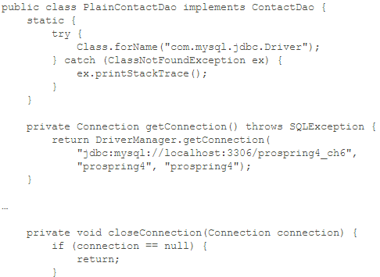
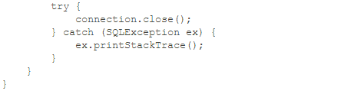
Listing 6-7: Managing a JDBC Connection
Notes:
This code is far from complete, but it gives you an idea of the steps you need in order to manage a JDBC connection.
This code does not even deal with connection pooling, which is a common technique for managing connections to the database more effectively.
We do not discuss connection pooling at this point (connection pooling is discussed in the "Database Connections and DataSources" section later in this chapter);
instead, in Listing 6-8, we show an implementation of the findAll(), insert(), and delete() methods of the ContactDao interface using plain JDBC.

Slide 16
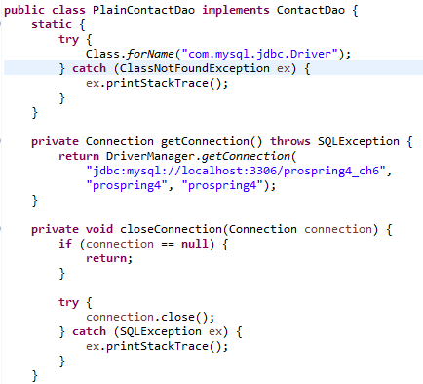
Listing 6-8: Plain JDBC DAO Implementation

Slide 17
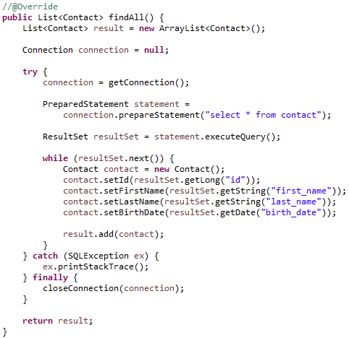

Slide 18
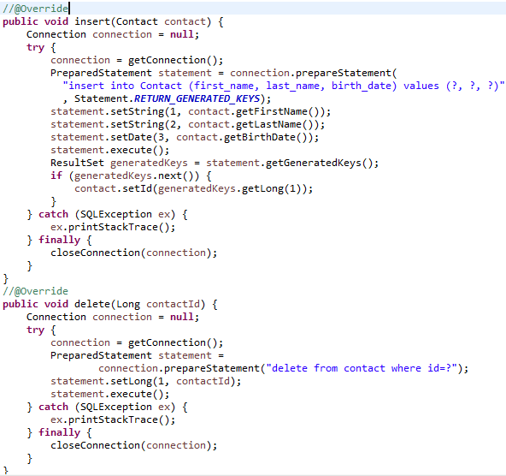

Slide 19
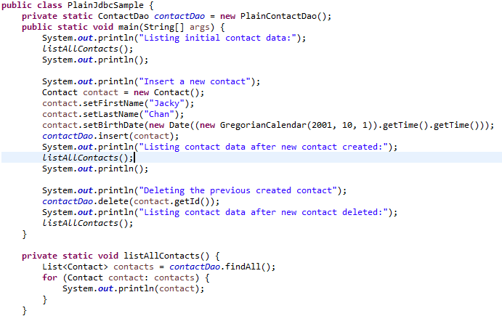
Listing 6-9: Pure JDBC Implementation Testing

Slide 20
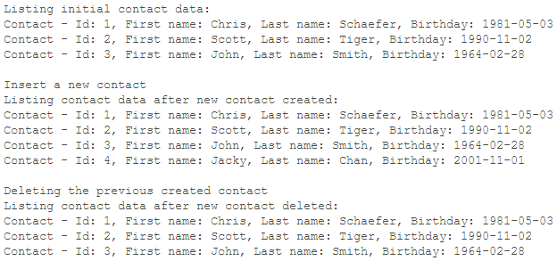
Running the program in Listing 6-9 yields the following result (assuming you have a locally installed MySQL database called prospring4_ch6 that has a username and password set to prospring4; it should be able to access the database schema, and you should run the scripts schema.sql and test-data.sql against the database to create the tables and populate the initial data):

Slide 21
As shown in the output, the first block of lines shows the initial data. The second block of lines shows that the new record was added. The final block of lines shows that the newly created contact was deleted.
As you can see in Listing 6-8 shown previously, a lot of code needs to be moved to a helper class, or even worse, duplicated in each DAO class.
This is the main disadvantage of JDBC from the application programmer's point of view—you just do not have time to write repetitive code in every DAO class.
Instead, you want to concentrate on writing code that actually does what you need the DAO class to do: select, update, and delete the data.
The more helper code you need to write, the more checked exceptions you need to handle, and the more bugs you may introduce in your code.
This is where a DAO framework and Spring come in.
A framework eliminates the code that does not actually perform any custom logic and allows you to forget about all the housekeeping that needs to be performed.
In addition, Spring's extensive JDBC support makes your life a lot easier.

Slide 22
Spring JDBC Infrastructure
The code we discussed in the first part of the chapter is not very complex, but it is tedious, and because there is so much of it to write, the likelihood of coding errors is quite high.
It is time to take a look at how Spring makes things easier and more elegant.
Overview and Used Packages
JDBC support in Spring is divided into the five packages detailed in Table 6-2; each handles different aspects of JDBC access.

Slide 23
Table 6-2: Spring JDBC Packages
Package | Description
org.springframework.jdbc. core | Contains the foundations of JDBC classes in Spring. It includes the core JDBC class, JdbcTemplate, which simplifies programming database operations with JDBC. Several subpackages provide support of JDBC data access with more-specific purposes (e.g., a JdbcTemplate class that supports named parameters) and related support classes as well.
org.springframework.jdbc. datasource | Contains helper classes and DataSource implementations that you can use to run JDBC code outside a JEE container. Several subpackages provide support for embedded databases, database initialization, and various data source lookup mechanisms.
Notes:
Let's start the discussion of Spring JDBC support by looking at the lowest-level functionality.
The first thing that needs to be done before running SQL queries is establishing a connection to the database

Slide 24
Table 6-2: Spring JDBC Packages
Package | Description
org.springframework.jdbc. object | Contains classes that help convert the data returned from the database into objects or lists of objects. These objects and lists are plain Java objects and therefore are disconnected from the database.
org.springframework.jdbc. support | The most important class in this package is SQLException translation support. This allows Spring to recognize error codes used by the database and map them to higher-level exceptions.
org.springframework.jdbc. config | Contains classes that support JDBC configuration within Spring's ApplicationContext. For example, it contains a handler class for the jdbc namespace (e.g., <jdbc:embedded-database> tags).

Slide 25
Database Connections and DataSources
You can use Spring to manage the database connection for you by providing a bean that implements javax.sql.DataSource.
The difference between a DataSource and a Connection is that a DataSource provides and manages Connections.
DriverManagerDataSource (under the package org.springframework.jdbc.datasource) is the simplest implementation of a DataSource.
By looking at the class name, you can guess that it simply calls DriverManager to obtain a connection.
The fact that DriverManagerDataSource doesn't support database connection pooling makes this class unsuitable for anything other than testing.
The configuration of DriverManagerDataSource is quite simple, as you can see in Listing 6-10; you just need to supply the driver class name, a connection URL, a username, and a password (datasource-drivermanager.xml).

Slide 26
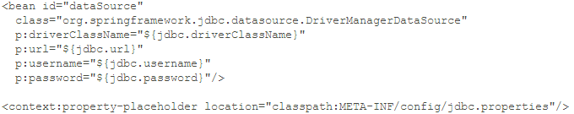
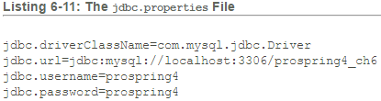
Listing 6-10: Spring-Managed DriverManagerDataSource dataSource Bean

Slide 27
In real-world applications, you can use the Apache Commons BasicDataSource (http://commons.apache.org/dbcp/) or a DataSource implemented by a JEE application server (for example, JBoss, WebSphere, WebLogic, or GlassFish), which may further increase the performance of the application.
You could use a DataSource in the plain JDBC code and get the same pooling benefits; however, in most cases, you would still miss a central place to configure the DataSource.
Spring, on the other hand, allows you to declare a dataSource bean and set the connection properties in the ApplicationContext definition files
(see Listing 6-12; the file name is datasource-dbcp.xml).

Slide 28
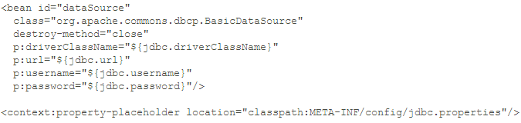
Listing 6-12: Spring-Managed dataSource Bean
Note Besides the Apache Commons BasicDataSource, other popular open source database connection pool libraries include C3P0 (www.mchange.com/projects/c3p0/index.html) and BoneCP (http://jolbox.com/).

Slide 29
This particular Spring-managed DataSource is implemented in org.apache.commons.dbcp.BasicDataSource. The most important bit is that the dataSource bean implements javax.sql.DataSource, and you can immediately start using it in your data access classes.
Another way to configure a dataSource bean is to use JNDI. If the application you are developing is going to run in a JEE container, you can take advantage of the container-managed connection pooling. To use a JNDI-based data source, you need to change the dataSource bean declaration, as shown in Listing 6-13(datasource-jndi.xml).
Listing 6-13: Spring-Managed JNDI dataSource Bean

Slide 30
In the previous example, we use Spring's JndiObjectFactoryBean to obtain the data source by JNDI lookup. Starting from version 2.5, Spring provides the jee namespace, which further simplifies the configuration.
Listing 6-14 shows the same JNDI data source configuration using the jee namespace (datasource-jee.xml).
Listing 6-14: Spring-Managed JNDI dataSource Bean (Using the jee Namespace)
In the previous listing, we declare the jee namespace in the <beans> tag and then the <jee:jndi-lookup> tag to declare the data source.
If you take the JNDI approach, you must not forget to add a resource reference (resource-ref) in the application descriptor file (see Listing 6-15).

Slide 31
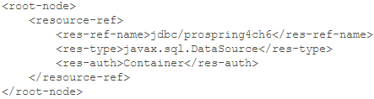
Listing 6-15: A Resource Reference in Descriptor Files
The <root-node> is a placeholder value; you need to change it depending on how your module is packaged.
For example, it becomes <web-app> in the web deployment descriptor (WEB-INF/web.xml) if the application is a web module.
Most likely, you will need to configure the resource-ref in an application server-specific descriptor file as well.
However, notice that the resource-ref element configures the jdbc/prospring4ch6 reference name and that the dataSource bean's jndiName is set to java:comp/env/jdbc/prospring4ch6.
As you can see, Spring allows you to configure the DataSource in almost any way you like, and it hides the actual implementation or location of the data source from the rest of the application's code.
In other words, your DAO classes do not know and do not need to know where the DataSource points.
The connection management is also delegated to the dataSource bean, which in turn performs the management itself or uses the JEE container to do all the work.

Slide 32
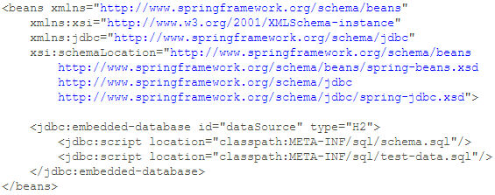
Embedded Database Support
Starting from version 3.0, Spring also offers embedded database support, which automatically starts an embedded database and exposes it as a DataSource for the application. Listing 6-16 shows the configuration of an embedded database (app-context-xml.xml).
Listing 6-16: Spring Embedded Database Support

Slide 33
In the previous listing, we first declare the jdbc namespace in the <beans> tag. Afterward, we use the <jdbc:embedded-database> to declare the embedded database and assign it an ID of dataSource.
Within the tag, we also instruct Spring to execute the scripts specified to create the database schema and populate testing data accordingly. Note that the order of the scripts is important, and the file that contains Data Definition Language (DDL) should always appear first, followed by the file with Data Manipulation Language (DML). For the type attribute, we specify the type of embedded database to use. As of version 4.0, Spring supports HSQL (the default), H2, and DERBY.
The embedded database support is extremely useful for local development or unit testing. Throughout the rest of this chapter, we use the embedded database to run the sample code, so your machine doesn't require a database to be installed in order to run the samples.
You can not only utilize the embedded database support via the JDBC namespace but also initialize a database instance running elsewhere, such as MySQL, Oracle, and so on. Rather than specifying type and embedded-database, simply use initialize-database, and your scripts will execute against the intended dataSource just as they would with an embedded database.

Slide 34
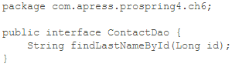
Using DataSources in DAO Classes
Let's create a ContactDao interface to implement for our sample, as shown in Listing 6-17.
Listing 6-17: ContactDao Interface
For the simple implementation, first we will add a dataSource property to the JdbcContactDao implementation class.
The reason we want to add the dataSource property to the implementation class rather than the interface should be quite obvious: the interface does not need to know how the data is going to be retrieved and updated.
By adding DataSource mutator methods to the interface, in the best-case scenario this forces the implementations to declare the getter and setter stubs. Clearly, this is not a very good design practice.
Take a look at the simple JdbcContactDao class in Listing 6-18.

Slide 35
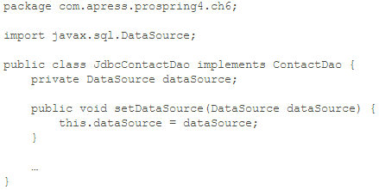
Listing 6-18: JdbcUserDao with the dataSource Property
We can now instruct Spring to configure our contactDao bean by using the JdbcContactDao implementation and set the dataSource property
(see Listing 6-19 for the enhanced app-context-xml.xml configuration).

Slide 36
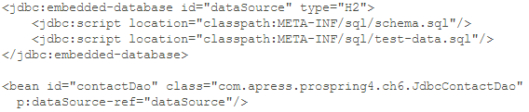
Listing 6-19: Spring Application Context File with dataSource and contactDao Beans
To support the H2 database, we need to add the dependency on the H2 database into the project, as shown in Table 6-3.
Group ID | Artifact ID | Version | Description
com.h2database | h2 | 1.3.172 | H2 database Java library

Slide 37
Spring now creates the contactDao bean by instantiating the JdbcContactDao class with the dataSource property set to the dataSource bean.
It is good practice to make sure that all required properties on a bean have been set. The easiest way to do this is to implement the InitializingBean interface and provide an implementation for the afterPropertiesSet() method (see Listing 6-20). This way, you make sure that all required properties have been set on your JdbcContactDao.
For further discussion of bean initialization, refer to Chapter 4.

Slide 38
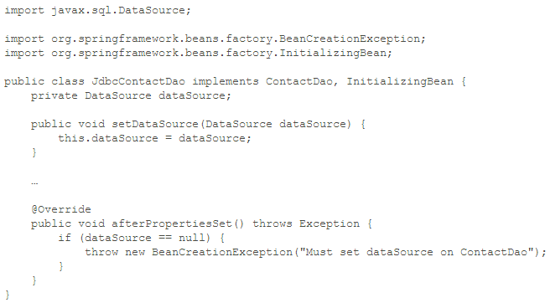
Listing 6-20: JdbcContactDao Implementation with InitializingBean
Notes:
The code we have looked at so far uses Spring to manage the data source and introduces the ContactDao interface and its JDBC implementation.
We also set the dataSource property on the JdbcContactDao class in the Spring ApplicationContext file.
Now we expand the code by adding the actual DAO operations to the interface and implementation.

Slide 39
Exception Handling
Because Spring advocates using runtime exceptions rather than checked exceptions, you need a mechanism to translate the checked SQLException into a runtime Spring JDBC exception.
Because Spring's SQL exceptions are runtime exceptions, they can be much more granular than checked exceptions.
By definition, this is not a feature of runtime exceptions, but it is very inconvenient to have to declare a long list of checked exceptions in the throws clause; hence, checked exceptions tend to be much more coarse-grained than their runtime equivalents.
Spring provides a default implementation of the SQLExceptionTranslator interface, which takes care of translating the generic SQL error codes into Spring JDBC exceptions. In most cases, this implementation is sufficient enough, but we can extend Spring's default implementation and set our new SQLExceptionTranslator implementation to be used in JdbcTemplate, as shown in Listing 6-21.

Slide 40
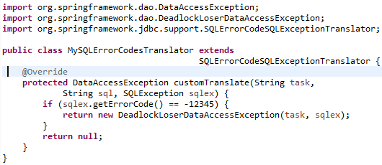
Listing 6-21: Custom SQLExceptionTranslator

Slide 41
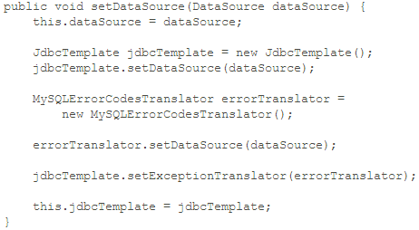
To use the custom translator, we need to pass it into JdbcTemplate in the DAO classes.
Listing 6-22 shows a sample code snippet from the enhanced JdbcContactDao.setDataSource() method to illustrate its usage.
Listing 6-22: Using Custom SQLExceptionTranslator in Spring Jdbc

Slide 42
Having the custom SQL exception translator in place, Spring will invoke it upon SQL exceptions detected when executing SQL statements against the database, and custom exception translation will happen when the error code is -12345. For other errors, Spring will fall back to its default mechanism for exception translation.
Obviously, nothing can stop you from creating SQLExceptionTranslator as a Spring-managed bean and using the JdbcTemplate bean in your DAO classes. Don't worry if you don't remember reading about the JdbcTemplate class; we are going to discuss it in more detail.

Slide 43
The JdbcTemplate Class
This class represents the core of Spring's JDBC support,
It can execute all types of SQL statements.
In the most simplistic view, you can classify the data definition and data manipulation statements.
Data definition statements cover creating various database objects (tables, views, stored procedures, and so on).
Data manipulation statements manipulate the data and can be classified as select and update statements. A select statement generally returns a set of rows; each row has the same set of columns. An update statement modifies the data in the database but does not return any results.
The JdbcTemplate class allows you to issue any type of SQL statement to the database and return any type of result.
In this section, we will go through several common use cases for JDBC programming in Spring with the JdbcTemplate class.

Slide 44
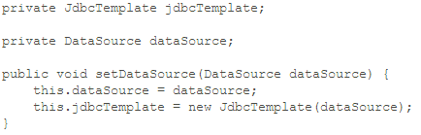
Initializing JdbcTemplate in a DAO Class
Before we discuss how to use JdbcTemplate, let's take a look at how to prepare JdbcTemplate for use in the DAO class. It's very straightforward; most of the time you just need to construct the class by passing in the data source object (which should be injected by Spring into the DAO class).
Listing 6-23 shows the code snippet that will initialize the JdbcTemplate object.
Listing 6-23: Initializing JdbcTemplate

Slide 45
The general practice is to initialize JdbcTemplate within the setDataSource method so that once the data source is injected by Spring, JdbcTemplate will also be initialized and ready for use.
Once configured, JdbcTemplate is thread safe. That means you can also choose to initialize a single instance of JdbcTemplate in Spring's XML configuration and have it inject into all DAO beans.
Note in the Spring Jdbc module, there is a class called JdbcDaoSupport. it wraps the JdbcTemplate class, and you can have your DAO classes extend the JdbcDaoSupport class. in this case, when the DAO class is injected with the data source, the JdbcTemplate will be initialized automatically.

Slide 46
Retrieving a Single-Value by Using JdbcTemplate
Let's start with a simple query that returns a single value. For example, we want to be able to retrieve the first name of a contact by its ID. Using JdbcTemplate, we can retrieve the value easily.
Listing 6-24 shows the implementation of the findFirstNameById() method in the JdbcContactDao class. For other methods, empty implementations were created.

Slide 47
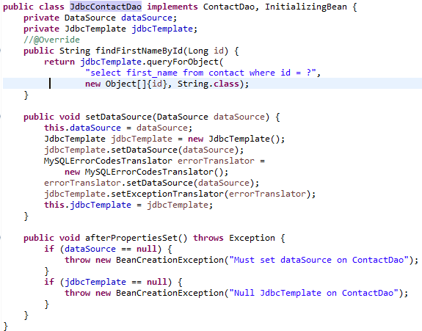
Listing 6-24: Using JdbcTemplate to Retrieve a Single Value
Notes:
jdbcTemplate.queryForObject(“selet first_name from contac where id = ?”, new Object[]{id}, String.class);

Slide 48
In the previous listing, we use the queryForObject() method of JdbcTemplate to retrieve the value of the first name.
The first argument is the SQL string, and the second argument consists of the parameters to be passed to the SQL for parameter binding in object array format.
The last argument is the type to be returned, which is String in this case. Besides Object, you can also query for other types such as Long and Integer.
Let's take a look at the outcome.
Listing 6-25 shows the testing program.

Slide 49
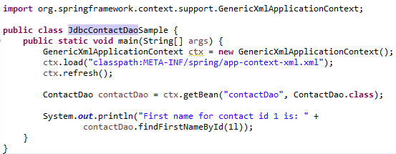
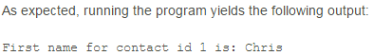
Listing 6-25: Selecting Data Using JdbcTemplate

Slide 50
Using Named Parameters with NamedParameterJdbcTemplate
In the previous example, we are using the normal placeholder (the ? character) as a query parameter, and we need to pass the parameter values as an Object array.
When using a normal placeholder, the order is important, and the order that you put the parameters into the array should be the same as the order of the parameters in the query.
Some developers prefer to use named parameters to ensure that each parameter is being bound exactly as intended.
In Spring, a variant of JdbcTemplate, called NamedParameterJdbcTemplate (under the package org.springframework.jdbc.core.namedparam), provides support for this.
The initialization of NamedParameterJdbcTemplate is the same as JdbcTemplate, so we just need to declare a variable with type NamedParameterJdbcTemplate and create a new instance of it in the setDataSource() method, as shown in Listing 6-26.

Slide 51
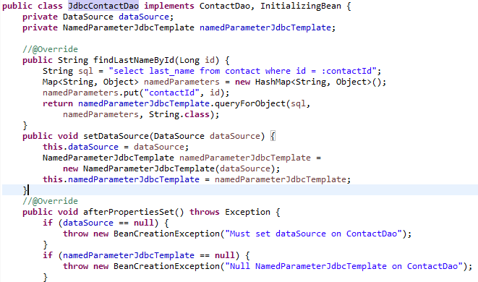
Listing 6-26: JdbcContactDao Using NamedParameterJdbcTemplate to find Last Name By ID

Slide 52
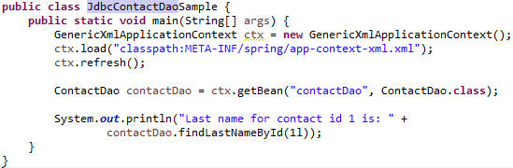
You will see that instead of the ? placeholder, the named parameter (prefixed by a semicolon) is used instead. Listing 6-27 shows our updated test program.
Listing 6-27: Updated JdbcContactDaoSample Test Program Using Named Parameters
Notes:
Let's run this program again, now using named parameters, and you should see the following output printed to the console:
Last name for contact id 1 is: Schaefer

Slide 53
Retrieving Domain Objects with RowMapper<T>
Rather than retrieving a single value, most of the time you will want to query one or more rows and then transform each row into the corresponding domain object.
Spring's RowMapper<T> interface (under the package org.springframework.jdbc.core) provides a simple way for you to perform mapping from a JDBC result set to POJOs.
Let's see it in action by implementing the findAll() method of the ContactDao using the RowMapper<T> interface.
Listing 6-28 shows the implementation of the findAll() method.

Slide 54
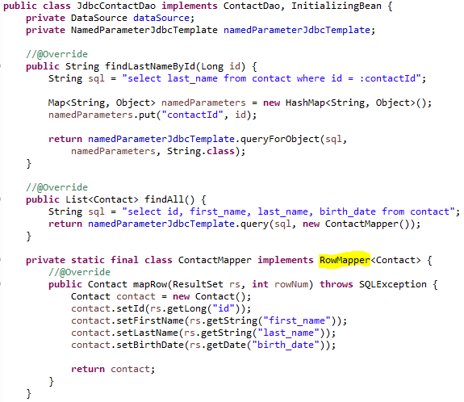
Listing 6-28: Use RowMapper<T> to Query Domain Objects

Slide 55
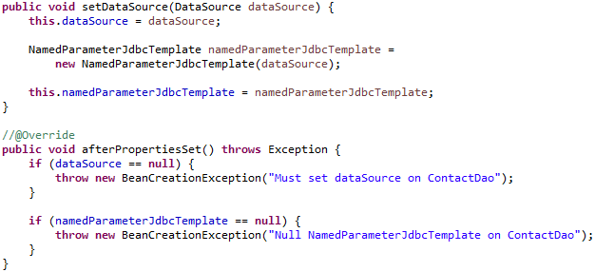

Slide 56
In the previous listing, we define a static inner class called ContactMapper that implements the RowMapper<T> interface.
The class needs to provide the mapRow() implementation, which transforms the values in a specific record of the ResultSet into the domain object you want.
Making it a static inner class allows you to share the RowMapper<T> among multiple finder methods.

Slide 57
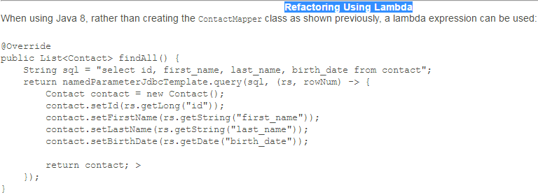
Afterward, the findAll() method just needs to invoke the query method and pass in the query string and the row mapper.
In case the query requires parameters, the query() method provides an overloaded method that accepts the query parameters.
Let's create our JdbcContactDaoSample as shown in Listing 6-29 to find all contacts.

Slide 58
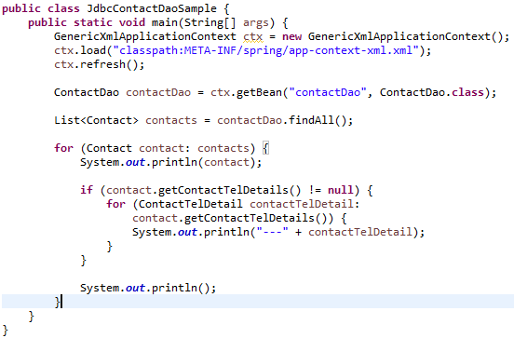
Listing 6-29: Listing Contacts

Slide 59
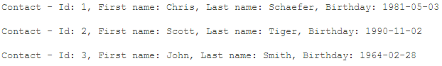
Running the program yields the following result (other outputs were omitted):

Slide 60
Retrieving Nested Domain Objects with ResultSetExtractor
Let's proceed to a somewhat more complicated example, in which we need to retrieve the data from the parent (CONTACT) and child (CONTACT_TEL_DETAIL) tables with a join and then transform the data back into the nested object (ContactTelDetail within Contact) accordingly.
The previously mentioned RowMapper<T> is suitable only for row mapping to a single domain object. For a more complicated object structure, we need to use the ResultSetExtractor interface. To demonstrate its use, let's add one more method, findAllWithDetail(), into the ContactDao interface. The method should populate the list of contacts with their telephone details.
Listing 6-30 shows the addition of the findAllWithDetail() method to the interface and the implementation of the method using ResultSetExtractor.

Slide 61
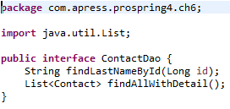
Listing 6-30: Using ResultSetExtractor to Query Domain Objects

Slide 62
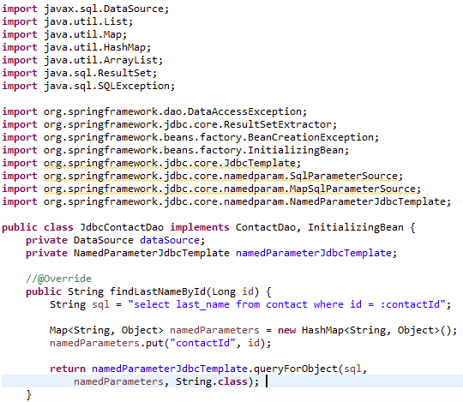

Slide 63
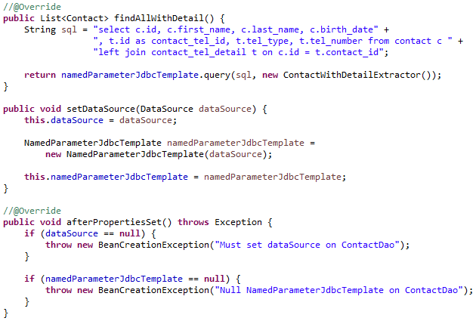

Slide 64
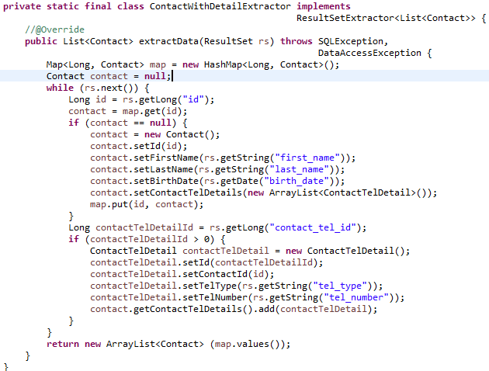

Slide 65
The code looks quite like the RowMapper sample, but this time we declare an inner class that implements ResultSetExtractor.
Then we implement the extractData() method to transform the result set into a list of Contact objects accordingly.
For the findAllWithDetail() method, the query uses a left join to join the two tables so that contacts with no telephones will also be retrieved.
The result is a Cartesian product of the two tables.
Finally, we use the JdbcTemplate.query() method, passing in the query string and the result set extractor.

Slide 66
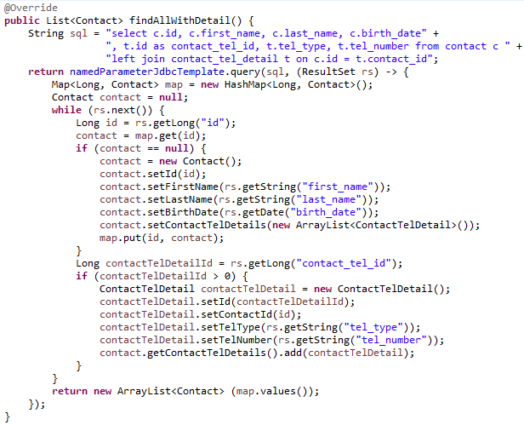
Refactoring Using Lambda
Notes:
When using Java 8, rather than creating the ContactWithDetailExtractor class as shown previously, a lambda expression can be used:

Slide 67
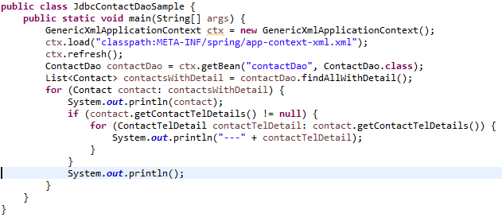
Listing 6-31: Listing Contacts with Details

Slide 68
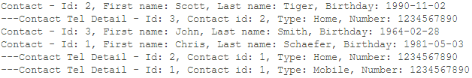
Run the testing program again, and it yields the following output:
You can see the contacts and their telephone details are listed accordingly. The data is based on the data population script in Listing 6-2.
So far, you have seen how to use JdbcTemplate to perform some common query operations.
JdbcTemplate (and the NamedParameterJdbcTemplate class too) also provides a number of overloading update() methods that support data update operations, including insert, update, delete, and so on.
However, the update() method is quite self-explanatory, so we leave it as an exercise for you to explore.
On the other side, as you will see in later sections, we will use the Spring-provided SqlUpdate class to perform data update operations.

Slide 69
Spring Classes That Model JDBC Operations
In the preceding section, you saw how JdbcTemplate and the related data mapper utility classes greatly simplify the programming model in developing data access logic with JDBC. Built on top of JdbcTemplate, Spring also provides a number of useful classes that model JDBC data operations and let developers maintain the query and transformation logic from ResultSet to domain objects in a more object-oriented fashion. Specifically, this section presents the following classes:
MappingSqlQuery<T>: The MappingSqlQuery<T> class allows you to wrap the query string together with the mapRow() method into a single class.
SqlUpdate: The SqlUpdate class allows you to wrap any SQL update statement into it. It also provides a lot of useful functions for you to bind SQL parameters, retrieve the RDBMS-generated key after a new record is inserted, and so on.
BatchSqlUpdate: As its name indicates, this class allows you to perform batch update operations. For example, you can loop through a Java List object and have the BatchSqlUpdate queue up the records and submit the update statements for you in a batch. You can set the batch size and flush the operation anytime as you want.
SqlFunction<T>: The SqlFunction<T> class allows you to call stored functions in the database with argument and return types. Another class, StoredProcedure, also exists that helps you invoke stored procedures.
Setting Up JDBC DAO by Using Annotations
First let's take a look at how to set up the DAO implementation class by using annotations. The following example code implements the ContactDao interface method by method until we have a full ContactDao implementation. Listing 6-32 shows the ContactDao interface class with a complete listing of the data access services it provides.

Slide 70
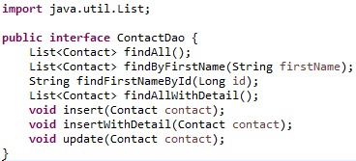
Listing 6-32: ContactDao Interface
In Listing 6-33, the initial declaration and injection of the data source property using the JSR-250 annotation is shown.

Slide 71
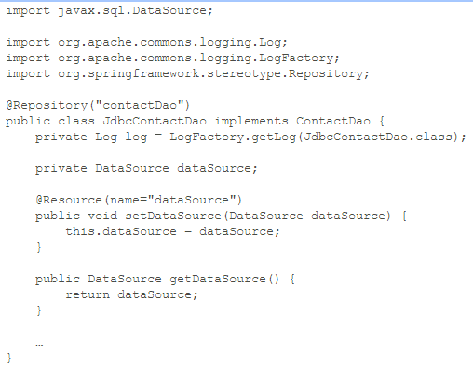
Listing 6-33: Declaring JdbcContactDao by Using Annotations

Slide 72
In the previous listing, we use @Repository to declare the Spring bean with a name of contactDao, and since the class contains data access code, @Repository also instructs Spring to perform database-specific SQL exceptions to the more application-friendly DataAccessException hierarchy in Spring.
We also declare the log variable by using Apache commons-logging to log the message within the program. We use JSR-250's @Resource for the dataSource property to let Spring inject the data source with a name of dataSource.
Listing 6-34 shows the XML configuration for Spring using annotations (app-context-annotation.xml).

Slide 73
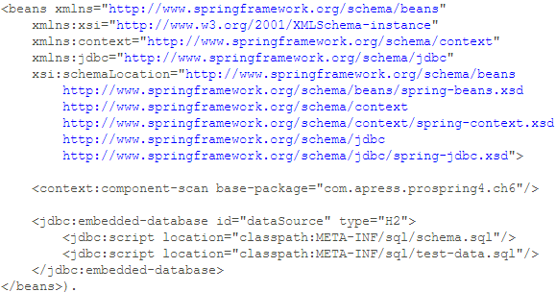
Listing 6-34: Spring Configuration Using Annotations
In this configuration, we declare the embedded database by using H2 and use <context:component-scan> for automatic Spring bean discovery.
Having the infrastructure in place, we can now proceed to the implementation of JDBC operations.

Slide 74
Querying Data by Using MappingSqlQuery<T>
Spring provides the MappingSqlQuery<T> class for modeling query operations.
Basically, we construct a MappingSqlQuery<T> class by using the data source and the query string.
We then implement the mapRow() method to map each ResultSet record into the corresponding domain object.
Let's begin by creating the SelectAllContacts class (which represents the query operation for selecting all contacts) that extends the MappingSqlQuery<T> abstract class.
Listing 6-35 shows the SelectAllContacts class.

Slide 75
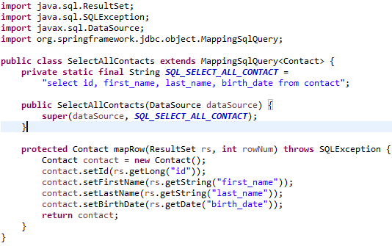
Listing 6-35: The SelectAllContacts Class

Slide 76
Within the SelectAllContacts class, the SQL for selecting all contacts is declared.
In the class constructor, the super() method is called to construct the class, using the DataSource as well as the SQL statement.
Moreover, the MappingSqlQuery<T>.mapRow() method is implemented to provide the mapping of the result set to the Contact domain object.
Having the SelectAllContacts class in place, we can implement the findAll() method in the JdbcContactDao class.
Listing 6-36 shows the class.
One point worth noting here is that MappingSqlQuery<T> is suitable only for mapping a single row to a domain object.
For a nested object, you still need to use JdbcTemplate with ResultSetExtractor, like the example method findAllWithDetail() presented in the JdbcTemplate class section.

Slide 77
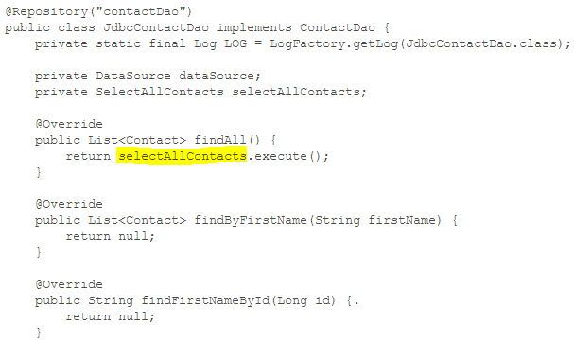
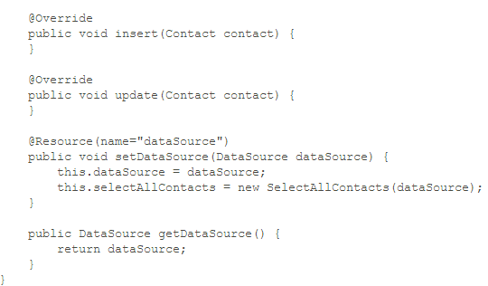
Listing 6-36: Implementing the findAll() Method
Notes:
In the setDataSource() method, upon the injection of the DataSource, an instance of the SelectAllContacts class is constructed.
In the findAll() method, we simply invoke the SelectAllContacts.execute() method, which is inherited from the SqlQuery<T> abstract class indirectly.
That's all we need to do. Listing 6-37 shows the sample program to test the logic.

Slide 78
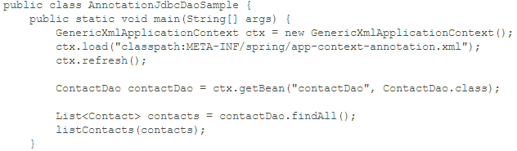

Listing 6-37: Testing MappingSqlQuery

Slide 79

Running the testing program yields the following output:
Since we set the logging properties to the DEBUG level, from the console output, you will also see the query that was submitted by Spring, as shown here:
Let's proceed to implement the findByFirstName() method, which takes one named parameter. As in the previous sample, we create the class SelectContactByFirstName for the operation,
which is shown in Listing 6-38.

Slide 80

Listing 6-38: The SelectContactByFirstName Class

Slide 81
The SelectContactByFirstName class is similar to the SelectAllContacts class.
First, the SQL statement is different and carries a named parameter called first_name.
In the constructor method, the declareParameter() method is called (which is inherited from the org.springframework.jdbc.object.RdbmsOperationabstract class indirectly).
Let's proceed to implement the findByFirstName() method in the JdbcContactDao class. Listing 6-39 shows the updated code.

Slide 82

Listing 6-39: Implementing the findByFirstName() Method

Slide 83


Slide 84
Upon data source injection, an instance of SelectContactByFirstName is constructed.
Afterward, in the findByFirstName() method, a HashMap is constructed with the named parameters and values.
Finally, the executeByNamedParam() method (inherited from SqlQuery<T> abstract class indirectly) is called.
Let's test this method by executing the code in Listing 6-40.

Slide 85

Listing 6-40: Testing the findByFirstName() Method

Slide 86
Running the program produces the following output from the findByFirstName() method:
One point worth noting here is that MappingSqlQuery<T> is suitable only for mapping a single row to a domain object.
For a nested object, you still need to use JdbcTemplate with ResultSetExtractor, like the example method findAllWithDetail() presented in the JdbcTemplate class section.

Slide 87

Updating Data by Using SqlUpdate
For updating data, Spring provides the SqlUpdate class.
Listing 6-41 shows the UpdateContact class that extends the SqlUpdate class for update operations.
Listing 6-41: The UpdateContact Class

Slide 88
The preceding listing should be familiar to you now. An instance of the SqlUpdate class is constructed with the query, and the named parameters are declared too.
Listing 6-42 shows the implementation of the update() method in the JdbcContactDao class.

Slide 89

Listing 6-42: Using SqlUpdate

Slide 90
Upon data source injection, an instance of UpdateContact is constructed.
In the update() method, a HashMap of named parameters is constructed from the passed-in Contact object, and then the updateByNamedParam() is called to update the contact record.
To test the operation, let's update the AnnotationJdbcDaoSample class, as shown in Listing 6-43.

Slide 91


Listing 6-43: Testing the update() Method

Slide 92

Here we simply construct a Contact object and then invoke the update() method.
Running the program produces the following output from the last listContacts()method:
In the output, you can see that the contact with an ID of 1 is updated accordingly.

Slide 93
Inserting Data and Retrieving the Generated Key
For inserting data, we can also use the SqlUpdate class.
One interesting point is how the primary key is generated (which is typically the id column).
This value is available only after the insert statement has completed, as the RDBMS generates the identity value for the record on insert.
The column ID is declared with the attribute AUTO_INCREMENT and is the primary key, and this value will be assigned by the RDBMS during the insert operation.
If you are using Oracle, you will probably get a unique ID first from an Oracle sequence and then execute an insert statement with the query result.
In old versions of JDBC, the method is a bit tricky. For example, if we are using MySQL, we need to execute the SQL select last_insert_id() and select @@IDENTITY statements for Microsoft SQL Server.
Luckily, starting from JDBC version 3.0, a new feature was added that allows the retrieval of an RDBMS-generated key in a unified fashion.
Listing 6-44 shows the implementation of the insert() method, which also retrieves the generated key for the inserted contact record.
It will work in most databases (if not all); just make sure you are using a JDBC driver that is compatible with JDBC 3.0 or newer.
We start by creating the InsertContact class for the insert operation, which extends the SqlUpdate class. Listing 6-44 shows the class.

Slide 94

Listing 6-44: The InsertContact Class

Slide 95
The InsertContact class is almost the same as the UpdateContact class; we need to do just two more things.
When constructing the InsertContact class, we call the method SqlUpdate.setGeneratedKeysColumnNames() to declare the name of the ID column.
The method SqlUpdate.setReturnGeneratedKeys() then instructs the underlying JDBC driver to retrieve the generated key.
Listing 6-45 shows the implementation of the insert() method in the JdbcContactDao class.

Slide 96

Listing 6-45: Using SqlUpdate for the Insert Operation

Slide 97
Upon data source injection, an instance of InsertContact is constructed.
In the insert() method, we also use the SqlUpdate.updateByNamedParam() method.
Additionally, we pass in an instance of KeyHolder to the method, which will have the generated ID stored in it.
After the data is inserted, we can then retrieve the generated key from the KeyHolder.
Listing 6-46 shows the updated AnnotationJdbcDaoSample class.

Slide 98

Listing 6-46: Testing the insert() Method

Slide 99

Running the program produces the following output from the last listContacts() method:
You can see that the new contact is inserted with an ID of 4 and retrieved correctly.

Slide 100
Batching Operations with BatchSqlUpdate
For batch operations, we use the BatchSqlUpdate class. The new insertWithDetail() method will insert both the contact and its telephone details into the database.
In order to be able to insert the telephone detail record, we need to create the InsertContactTelDetail class, which is shown in Listing 6-47.

Slide 101

Listing 6-47: The InsertContactTelDetail Class
Note that in the constructor, we call the BatchSqlUpdate.setBatchSize() method to set the batch size for the JDBC insert operation.
Listing 6-48 shows the implementation of the insertWithDetail() method in the JdbcContactDao class.

Slide 102

Listing 6-48: Batch SQL Update Operation
insertWithDetail() from JdbcContactDao.java

Slide 103
Each time the insertWithDetail() method is called, a new instance of InsertContactTelDetail is constructed, as the BatchSqlUpdate class is not thread safe.
Then we use it just like SqlUpdate.
One main difference is that the BatchSqlUpdate class will queue up the insert operations and submit them to the database in batch.
Every time the number of records equals the batch size, Spring will execute a bulk insert operation to the database for the pending records.
On the other hand, upon completion, we call the BatchSqlUpdate.flush() method to instruct Spring to flush all pending operations (that is, the insert operations being queued that still haven't reached the batch size yet).
Finally, we loop through the list of ContactTelDetail objects in the Contact object and invoke the BatchSqlUpdate.updateByNamedParam() method.
To facilitate testing, the findAllWithDetail() method is also implemented.

Slide 104

Refactoring with Lambda
Notes:
When using Java 8, rather than creating the ContactWithDetailExtractor class as shown previously, a lambda expression can be used:

Slide 105

Listing 6-49 shows the updated AnnotationJdbcDaoSample class for testing the batch insert operation.
Listing 6-49: Testing the insertWithDetail() Method

Slide 106



Slide 107


Slide 108
Calling Stored Functions by Using SqlFunction
Spring also provides classes to simplify the execution of stored procedures/functions using JDBC.
In this section, we show you how to execute a simple function by using the SqlFunction class.
We will use MySQL for the database, create a stored function, and call it by using the SqlFunction<T> class.
We're assuming you have a MySQL database with a schema called prospring4_ch6, with a username and password both equaling prospring4 (the same as the example in the section "Exploring the JDBC Infrastructure").
Let's create a stored function called getFirstNameById(), which accepts the contact's ID and returns the first name of the contact.
Listing 6-50 shows the script to create the stored function in MySQL (stored-function.sql). Run the script against the MySQL database.

Slide 109

Listing 6-50: Stored Function for MySQL
The stored function simply accepts the ID and returns the first name of the contact record with the ID.
Next we create a StoredFunctionFirstNameById class to represent the stored function operation, which extends the SqlFunction<T> class.
Listing 6-51 shows the class.

Slide 110

Listing 6-51: The StoredFunctionFirstNameById Class

Slide 111
Here the class extends SqlFunction<T> and passes in the type String, which indicates the return type of the function.
Then we declare the SQL to call the stored function in MySQL.
Afterward, in the constructor, the parameter is declared, and we compile the operation.
The class is now ready for use in the implementation class.
Listing 6-52 shows the updated JdbcContactDao class to use the stored function.

Slide 112

Listing 6-52: The JdbcContactDao Class Using the Stored Function

Slide 113
Upon data source injection, an instance of StoredFunctionFirstNameById is constructed.
Then in the findFirstNameById() method, its execute() method is called, passing in the contact ID.
The method will return a list of Strings, and we need only the first one, because there should be only one record returned in the result set.
When using Java 8, rather than creating the ContactWithDetailExtractor class as shown previously, a lambda expression can be used:

Slide 114

Listing 6-53 shows the updated Spring configuration file for connecting to MySQL (app-context-annotation.xml
Listing 6-53: Spring Configuration for MySQL

Slide 115
The file datasource-dbcp.xml is imported, which holds the data source configuration to the MySQL database.
To run the program, the dependency on commons-dbcp should be added to the project, as shown in Table 6-5
Group ID | Artifact ID | Version | Description
commons-dbcp | commons-dbcp | 1.4 | Apache commons-dbcp database connection pool library

Slide 116

Listing 6-54: Testing the Stored Function in MySQL

Slide 117

In the program, we pass an ID of 1 into the stored function.
This will return Chris as the first name if you ran the test-data.sql against the MySQL database.
Running the program produces the following output:
You can see that the first name is retrieved correctly.
What is presented here is just a simple sample to demonstrate the Spring JDBC module's function capabilities. Spring also provides other classes (for example, StoredProcedure) for you to invoke complex stored procedures that return complex data types.
We recommend you refer to Spring's reference manual in case you need to access stored procedures using JDBC.

Slide 118
Spring Data Project: JDBC Extensions
In recent years, database technology has evolved so quickly with the rise of so many purpose-specific databases, nowadays an RDBMS is not the only choice for an application's back-end database.
In response to this database technology evolution and the developer community's needs, Spring created the Spring Data project (www.springsource.org/spring-data).
The major objective of the project is to provide useful extensions on top of Spring's core data access functionality to interact with databases other than traditional RDBMSs.
The Spring Data project comes with various extensions.
One that we would like to mention here is JDBC Extensions (www.springsource.org/spring-data/jdbc-extensions).
As its name implies, the extension provides some advanced features to facilitate the development of JDBC applications using Spring.

Slide 119
The main features that JDBC Extensions provides are listed here:
QueryDSLsupport: QueryDSL (www.querydsl.com) is a domain-specific language that provides a framework for developing type-safe queries. Spring Data's JDBC Extensions provides QueryDslJdbcTemplate to facilitate the development of JDBC applications using QueryDSL instead of SQL statements.
Advanced support for Oracle Database: The extension provides advanced features for Oracle Database users. On the database connection side, it supports Oracle-specific session settings, as well as Fast Connection Failover technology when working with Oracle RAC. Also, classes that integrate with Oracle Advanced Queueing are provided. On the data-type side, native support for Oracle's XML types, STRUCT and ARRAY, and so on, are provided.
If you are developing JDBC applications using Spring with Oracle Database, JDBC Extensions is really worth a look.

Slide 120
Considerations for Using JDBC
With this rich feature set, you can see how Spring can make your life much easier when using JDBC to interact with the underlying RDBMS. However, there is still quite a lot of code you need to develop, especially when transforming the result set into the corresponding domain objects.
On top of JDBC, a lot of open source libraries have been developed to help close the gap between the relational data structure and Java's OO model. For example, iBATIS is a popular DataMapper framework that is also based on SQL mapping. iBATIS lets you map objects with stored procedures or queries to an XML descriptor file. Like Spring, iBATIS provides a declarative way to query object mapping, greatly saving you the time it takes to maintain SQL queries that may be scattered around various DAO classes.
There are also many other ORM frameworks that focus on the object model, rather than the query. Popular ones include Hibernate, EclipseLink (also known as TopLink), and OpenJPA. All of them comply with the JCP's JPA specification.
In recent years, these ORM tools and mapping frameworks have become much more mature so that most developers will settle on one of them, instead of using JDBC directly. However, in cases where you need to have absolute control over the query that will be submitted to the database for performance purposes (for example, using a hierarchical query in Oracle), Spring JDBC is really a viable option. And when using Spring, one great advantage is that you can mix and match different data access technologies. For example, you can use Hibernate as the main ORM and then JDBC as a supplement for some of the complex query logic or batch operations; you can mix and match them in a single business operation and then wrap them under the same database transaction. Spring will help you handle those situations easily.

Slide 121
Summary
This chapter showed you how to use Spring to simplify JDBC programming.
You learned how to connect to a database and perform selects, updates, deletes, and inserts, as well as call database stored functions.
Using the core Spring JDBC class, JdbcTemplate, was discussed in detail. In addition, we covered other Spring classes that are built on top of JdbcTemplate and that help you model various JDBC operations.
We also showed how to use the new lambda expressions from Java 8 where appropriate.
In the next couple of chapters, we will discuss how to use Spring with popular ORM technologies when developing data access logic.

Slide 122
Chapter 7: Using Hibernate in Spring

Slide 123
Overview
In the previous chapter, you saw how to use JDBC in Spring applications. However, even though Spring goes a long way toward simplifying JDBC development, you still have a lot of code to write. In this chapter, we cover one of the object-relational mapping (ORM) libraries called Hibernate.
If you have experience developing data access applications using EJB entity beans (prior to EJB 3.0), you may remember the painful process. Tedious configuration of mappings, transaction demarcation, and much boilerplate code in each bean to manage its life cycle greatly reduced productivity when developing enterprise Java applications.
Just like Spring was developed to embrace POJO-based development and declarative configuration management rather than EJB's heavy and clumsy setup, the developer community realized that a simpler, lightweight, and POJO-based framework could ease the development of data access logic. Since then, many libraries have appeared; they are generally referred to as ORM libraries. The main objectives of an ORM library are to close the gap between the relational data structure in the relational database management system (RDBMS) and the object oriented (OO) model in Java so that developers can focus on programming with the object model and at the same time easily perform actions related to persistence.
Out of the ORM libraries available in the open source community, Hibernate is one of the most successful. Its features, such as a POJO-based approach, ease of development, and support of sophisticated relationship definitions, have won the heart of the mainstream Java developer community.

Slide 124
Hibernate's popularity has also influenced the JCP, which developed the Java Data Objects (JDO) specification as one of the standard ORM technologies in Java EE. Starting from EJB 3.0, the EJB entity bean was even replaced with the Java Persistence API (JPA). JPA has a lot of concepts that were influenced by popular ORM libraries such as Hibernate, TopLink, and JDO.
The relationship between Hibernate and JPA is also very close. Gavin King, the founder of Hibernate, represented JBoss as one of the JCP expert group members in defining the JPA specification. Starting from version 3.2, Hibernate provides an implementation of JPA. That means when you develop applications with Hibernate, you can choose to use either Hibernate's own API or the JPA API with Hibernate as the persistence service provider.
Having offered a rough history of Hibernate, this chapter will cover how to use Spring with Hibernate when developing data access logic. Hibernate is such an extensive ORM library that covering every aspect in just one chapter is simply not possible, and numerous books are dedicated to discussing Hibernate.

Slide 125
This chapter covers the basic ideas and main use cases of Hibernate in Spring. In particular, we discuss the following topics:
Configuring the Hibernate SessionFactory: The core concept of Hibernate revolves around the Session interface, which is managed by SessionFactory. We show how to configure Hibernate's session factory to work in a Spring application.
Major concepts of ORMs using Hibernate: We go through the major concepts of how to use Hibernate to map a POJO to the underlying relational database structure. Some commonly used relationships, including one-to-many and many-to-many, are also discussed.
Data operations: We present examples of how to perform data operations (query, insert, update, delete) by using Hibernate in the Spring environment. When working with Hibernate, its Session interface is the main interface that we will interact with.

Slide 126
Note: When defining object-to-relational mappings, Hibernate supports two configuration styles.
One is configuring the mapping information in XML files, and the other is using Java annotations within the entity classes (in the ORM or JPA world, a Java class that is mapped to the underlying relational database structure is called an entity class).
This chapter focuses on using the annotation approach for object-relational mapping.
For the mapping annotation, we use the JPA standards (for example, under the javax.persistence package), because they are interchangeable with hibernate's own annotations and will help you with future migrations to a JPA environment.

Slide 127

Sample Data Model for Example Code
Figure 7-1 shows the data model used in this chapter.
Notes:
As shown in this data model, two new tables were added, namely, HOBBY and CONTACT_HOBBY_DETAIL (the join table), which models the many-to-many relationships between the CONTACT and HOBBY tables.
On the other hand, a VERSION column was added to the CONTACT and CONTACT_TEL_DETAIL tables for optimistic locking, which we discuss in detail later. In the examples in this chapter, we use the embedded H2 database, so the database name is not required.
Listings 7-1 and 7-2 show the scripts for schema creation and sample data population.

Slide 128

Listing 7-1: Sample Data Model Creation Script (schema.sql)

Slide 129

Listing 7-1: Sample Data Model Creation Script (schema.sql)

Slide 130

Listing 7-2: Data Population Script (test-data.sql)

Slide 131

Configuring Hibernate SessionFactory
As mentioned earlier in this chapter, the core concept of Hibernate is based on the Session interface, which is obtained from SessionFactory. Spring provides classes to support the configuration of Hibernate's session factory as a Spring bean with the desired properties. In order to use Hibernate, you must add the Hibernate dependency, as shown in Table 7-1.

Slide 132

Listing 7-3: Spring Configuration for Hibernate's SessionFactory
Notes:
In the previous configuration, several beans were declared in order to be able to support Hibernate's session factory. The main configurations are listed here:
The dataSource bean: We declared the data source with an embedded database by using H2.
The transactionManager bean: The Hibernate session factory requires a transaction manager for transactional data access.
Spring provides a transaction manager specifically for Hibernate 4 (org.springframework.orm.hibernate4.HibernateTransactionManager).
The bean was declared with the ID transactionManager assigned.
By default, Spring will look up the bean with the name transactionManager within its ApplicationContext whenever transaction management is required.
We discuss transactions in detail in Chapter 9.
In addition, we declare the tag <tx:annotation-driven> to support the declaration of transaction demarcation requirements using annotations.
Component scan: This tag should be familiar to you. We instruct Spring to scan the components under the package com.apress.prospring4.ch7.
Hibernate SessionFactory bean:
The sessionFactory bean is the most important part.
Within the bean, several properties are provided.
First we need to inject the data source bean into the session factory.
Second, we instruct Hibernate to scan for the domain objects under the package com.apress.prospring4.ch7.
Finally, the hibernateProperties property provides configuration details for Hibernate.
There are many configuration parameters, and we define only a few important properties that should be provided for every application.
Table 7-2 lists the main configuration parameters for the Hibernate session factory.

Slide 133
In the previous configuration, several beans were declared in order to be able to support Hibernate's session factory.
The main configurations are listed here:
The dataSource bean: We declared the data source with an embedded database by using H2.
The transactionManager bean:
The Hibernate session factory requires a transaction manager for transactional data access.
Spring provides a transaction manager specifically for Hibernate4 (org.springframework.orm.hibernate4.HibernateTransactionManager).
The bean was declared with the ID transactionManager assigned.
By default, Spring will look up the bean with the name transactionManager within its ApplicationContext whenever transaction management is required.
We discuss transactions in detail in Chapter 9.
In addition, we declare the tag <tx:annotation-driven> to support the declaration of transaction demarcation requirements using annotations.

Slide 134
Component scan: This tag should be familiar to you. We instruct Spring to scan the components under the package com.apress.prospring4.ch7.
Hibernate SessionFactory bean:
The sessionFactory bean is the most important part.
Within the bean, several properties are provided.
First we need to inject the data source bean into the session factory.
Second, we instruct Hibernate to scan for the domain objects under the package com.apress.prospring4.ch7.
Finally, the hibernateProperties property provides configuration details for Hibernate.
There are many configuration parameters, and we define only a few important properties that should be provided for every application. Table 7-2 lists the main configuration parameters for the Hibernate session factory.

Slide 135
Table 7-2: Main Hibernate Configurations
For the full list of properties that Hibernate supports, please refer to Hibernate's reference manual on configuration (http://docs.jboss.org/hibernate/core/4.3/manual/en-US/html/ch03.html).
Property | Description
hibernate.dialect | The database dialect for the queries that Hibernate should use. Hibernate supports the SQL dialects for many databases. Those dialects are subclasses of org.hibernate.dialect.Dialect. Major dialects include H2Dialect, Oracle10gDialect, PostgreSQLDialect, MySQLDialect, SQLServerDialect, and so on.
hibernate.max_fetch_depth | Declares the "depth" for outer joins when the mapping objects have associations with other mapped objects. This setting prevents Hibernate from fetching too much data with a lot of nested associations. A commonly used value is 3.
hibernate.jdbc.fetch_size | The number of records from the underlying JDBC ResultSet that Hibernate should use to retrieve the records from the database for each fetch. For example, a query was submitted to the database, and the ResultSet contains 500 records. If the fetch size is 50, Hibernate will need to fetch 10 times to get all the data.

Slide 136
hibernate.jdbc.batch_size | Instructs Hibernate on the number of update operations that should be grouped together into a batch. This is very useful for performing batch job operations in Hibernate. Obviously, when we are doing a batch job updating hundreds of thousands of records, we would like Hibernate to group the queries in batches, rather than submit the updates one by one.
hibernate.show_sql | Indicates whether Hibernate should output the SQL queries to the log file or console. You should turn this on in a development environment, which can greatly help in the testing and troubleshooting process.

Slide 137
ORM Mapping Using Hibernate Annotations
Having the configuration in place, the next step is to model the Java POJO entity classes and their mapping to the underlying relational data structure.
There are two approaches to the mapping.
The first one is to design the object model and then generate the DB scripts based on the object model.
For example, for the session factory configuration, you can pass in the Hibernate property hibernate.hbm2ddl.auto to have Hibernate automatically export the schema DDL to the database.
The second approach is to start with the data model and then model the POJOs with the desired mappings.
We prefer the latter approach, because we can have more control of the data model, which is very useful in optimizing the performance of data access.
Based on the data model, Figure 7-2 shows the corresponding OO model with a class diagram.

Slide 138

Figure 7-2: Class diagram for the sample data model
You can see there is a one-to-many relationship between Contact and ContactTelDetail, while there's a many-to-many relationship between the Contact and Hobby objects.

Slide 139
Simple Mappings
First let's start by mapping the simple attributes of the class. Listing 7-4 shows the Contact class with the mapping annotations.
First, we annotate the type with @Entity, which means that this is a mapped entity class.
The @Table annotation defines the table name in the database that this entity is being mapped to.
For each mapped attribute, we annotate it with the @Column annotation, with the column names provided.
You can skip the table and column names if the type and attribute names are exactly the same as the table and column names.

Slide 140

Listing 7-4: The Contact Class

Slide 141
About the mappings, we would like to highlight a few points:
For the birth date attribute, we annotate it with @Temporal, using the TemporalType.DATE value. This means we would like to map the data type from the Java date type (java.util.Date) to the SQL date type (java.sql.Date). This allows us to access the attribute birthDate in the Contact object by using java.util.Date as usual in our application.
For the id attribute, we annotate it with @Id. This means it's the primary key of the object. Hibernate will use it as the unique identifier when managing the contact entity instances within its session. Additionally, the @GeneratedValue annotation tells Hibernate how the id value was generated. The IDENTITY strategy means that the id was generated by the backend during insert.

Slide 142
For the version attribute, we annotate it with @Version.
This instructs Hibernate that we would like to use an optimistic locking mechanism, using the version attribute as a control.
Every time Hibernate updates a record, it compares the version of the entity instance to that of the record in the database.
If both versions are the same, it means that no one updated the data before, and Hibernate will update the data and increment the version column.
However, if the version is not the same, it means that someone has updated the record before, and Hibernate will throw a StaleObjectStateException exception, which Spring will translate to HibernateOptimisticLockingFailureException.
In the example, we used an integer for version control.
Instead of an integer, Hibernate also supports using a timestamp.
However, using an integer for version control is recommended since Hibernate will always increment the version number by 1 after each update.
When using a timestamp, Hibernate will update the latest timestamp after each update. A timestamp is slightly less safe, because two concurrent transactions may both load and update the same item in the same millisecond.
Another mapped object is ContactTelDetail, which is shown in Listing 7-5.

Slide 143

Listing 7-5: The ContactTelDetail Class

Slide 144
One-to-Many Mappings
Hibernate has the capability to model many kinds of associations.
The most common associations are one-to-many and many-to-many.
Each Contact will have zero or more telephone numbers, so it's a one-to-many association (in ORM terms, the one-to-many association is used to model both zero-to-many and one-to-many relationships within the data structure).
Listing 7-7 shows the updated Contact class for mapping with the ContactTelDetail class.
Listing 7-8 shows the updated code in the ContactTelDetail class for the association mapping.

Slide 145

Listing 7-7: One-to-Many Association
The getter method of the attribute contactTelDetails is annotated with @OneToMany, which indicates the one-to-many relationship with the ContactTelDetail class.
Several attributes are passed to the annotation.
The mappedBy attribute indicates the property in the ContactTelDetail class that provides the association (that is, linked up by the foreign-key definition in the CONTACT_TEL_DETAIL table).
The cascade attribute means that the update operation should cascade to the child.
The orphanRemoval attribute means that after the contact telephone details have been updated, those entries that no longer exist in the set should be deleted from the database.

Slide 146

Listing 7-8: One-to-Many Mapping in ContactTelDetail
In Listing 7-8, We annotate the getter method of the contact attribute with @ManyToOne, which indicates it's the other side of the association from Contact.
We also specify the @JoinColumn annotation for the underlying foreign-key column name. Finally, the toString() method is overridden to facilitate testing output the example code later.

Slide 147
Listing 7-7: One-to-Many Association
Listing 7-8: One-to-Many Mapping in ContactTelDetail
Notes:
The getter method of the attribute contactTelDetails is annotated with @OneToMany, which indicates the one-to-many relationship with the ContactTelDetail class.
Several attributes are passed to the annotation.
The mappedBy attribute indicates the property in the ContactTelDetail class that provides the association (that is, linked up by the foreign-key definition in the CONTACT_TEL_DETAIL table).
The cascade attribute means that the update operation should cascade to the child.
The orphanRemoval attribute means that after the contact telephone details have been updated, those entries that no longer exist in the set should be deleted from the database.
Listing 7-8 shows the updated code in the ContactTelDetail class for the association mapping.
We annotate the getter method of the contact attribute with @ManyToOne, which indicates it's the other side of the association from Contact.
We also specify the @JoinColumn annotation for the underlying foreign-key column name.

Slide 148

Many-to-Many Mappings
Every contact has zero or more hobbies, and each hobby is also associated with zero or more contacts, which means it's a many-to-many mapping. A many-to-many mapping requires a join table, which is the CONTACT_HOBBY_DETAIL table in Figure 7-2.
Listing 7-9 shows the updated code in the Contact class to model the relationship.
Listing 7-9: Many-to-Many Association
In Listing 7-9, The getter method of the attribute hobbies in the Contact class is annotated with @ManyToMany. We also provide @JoinTable to indicate the underlying join table that Hibernate should look for. The name is the join table's name, the joinColumns defines the column that is the foreign key to the CONTACT table, and inverseJoinColumns defines the column that is the foreign key to the other side of the association (that is, the HOBBY table).
Listing 7-10 shows the updated code in the Hobby class.
The mapping is more or less the same as Listing 7-9, but the joinColumns and inverseJoinColumns attributes are reversed to reflect the association.
Notes:
Listing 7-10: Many-to-Many Mapping in the Hobby Class
@ManyToMany
@JoinTable(name = "contact_hobby_detail",
joinColumns = @JoinColumn(name = "HOBBY_ID"),
inverseJoinColumns = @JoinColumn(name = "CONTACT_ID")
)
public Set<Contact> getContacts() {
return this.contacts;
}

Slide 149

The Hibernate Session Interface
In Hibernate, when interacting with the database, the main interface you need to deal with is the Session interface, which is obtained from SessionFactory.
Listing 7-11 shows the ContactDaoImpl class used in the samples in this chapter and has the configured Hibernate SessionFactory injected into the class.
As usual, we declare the DAO class as a Spring bean by using the @Repository annotation. The @Transactional annotation defines the transaction requirements that we discuss further in Chapter 9. The sessionFactory attribute is injected by using the @Resource annotation.
Notes:
Listing 7-11: Injecting Hibernate SessionFactory

Slide 150

Database Operations with Hibernate
Listing 7-12 shows the ContactDao interface, which outlines the contract of contact data access services we are going to provide for contacts.
The interface is very simple; it has just three finder methods, one save method, and one delete method. The save() method will perform both the insert and update operations.

Slide 151
Querying Data by Using Hibernate Query Language
Hibernate, together with other ORM tools such as JDO and JPA, is engineered around the object model.
So, after the mappings are defined, we don't need to construct SQL to interact with the database.
Instead, for Hibernate, we use the Hibernate Query Language (HQL) to define our queries.
When interacting with the database, Hibernate will translate the queries into SQL statements on our behalf.
When coding HQL queries, the syntax is quite like SQL. However, you need to think on the object side rather than database side. We go through several examples in the following sections.

Slide 152

Simple Query with Lazy Fetching
Let's begin by implementing the findAll() method, which simply retrieves all the contacts from the database.
Listing 7-13 shows the updated code for this functionality.

Slide 153

Listing 7-14 shows a simple testing program for ContactDaoImpl.

Slide 154
Running the previous class yields the following output:
Listing contacts without details:
Contact - Id: 1, First name: Chris, Last name: Schaefer, Birthday: 1981-05-03
Contact - Id: 2, First name: Scott, Last name: Tiger, Birthday: 1990-11-02
Contact - Id: 3, First name: John, Last name: Smith, Birthday: 1964-02-28
Although the contact records were retrieved, what about the telephone and hobby details?
Let's modify the testing class to print the details information. Listing 7-15 shows the updated class to do so.

Slide 155

Listing 7-15: Testing the ContactDaoImpl Class
Notes:
If you run the program again, you will see the following exception:
Listing contacts with details:
Contact - Id: 1, First name: Chris, Last name: Schaefer, Birthday: 1981-05-03
Exception in thread "main" org.hibernate.LazyInitializationException:
…
You will see Hibernate throw the LazyInitializationException when you try to access the associations.
It's because, by default, Hibernate will fetch the associations "lazily," which means that Hibernate will not join the association tables (that is, CONTACT_TEL_DETAIL) for records.
The rationale behind this is for performance, since as you can imagine, if a query is retrieving thousands of records and all the associations are retrieved, the massive amount of data transfer will degrade performance.

Slide 156

You will see Hibernate throw the LazyInitializationException when you try to access the associations.
It's because, by default, Hibernate will fetch the associations "lazily," which means that Hibernate will not join the association tables (that is, CONTACT_TEL_DETAIL) for records.
The rationale behind this is for performance, since as you can imagine, if a query is retrieving thousands of records and all the associations are retrieved, the massive amount of data transfer will degrade performance.

Slide 157
Query with Associations Fetching
To have Hibernate fetch the data from associations, there are two options.
First, you can define the association with the fetch mode EAGER, for example:@ManyToMany(fetch=FetchType.EAGER). This tells Hibernate to fetch the associated records in every query. However, as discussed, this will impact data retrieval performance.
The other option is to force Hibernate to fetch the associated records in the query when required.
If you use the Criteria query, you can call the functionCriteria.setFetchMode() to instruct Hibernate to eagerly fetch the association.
When using NamedQuery, you can use the "fetch" operator to instruct Hibernate to fetch the association eagerly.
Let's take a look at the implementation of the findAllWithDetail() method, which will retrieve all contact information together with their telephone details and hobbies. In this example, we will use the NamedQuery approach. NamedQuery can be externalized into an XML file or declared using an annotation on the entity class.
Listing 7-16 shows the revised Contact domain object with the named query defined using annotations.

Slide 158

Listing 7-16: Using NamedQuery

Slide 159


Listing 7-17 shows the implementation of the findAllWithDetail() method.
This time we use the Session.getNamedQuery() method, passing in the name of the NamedQuery. Modifying the testing program (SpringHibernateSample) to call ContactDao.findAllWithDetail() will yield the following output:
Now all the contacts with details were retrieved correctly.

Slide 160

Let's see another example with NamedQuery with parameters. This time, we will implement the findById()method and would like to fetch the associations as well. Listing 7-18 shows the Contact class with the new named query added.
From the named query with the name Contact.findById, we declare a named parameter :id. Listing 7-19 shows the implementation of the findById() in ContactDaoImpl.

Slide 161

Listing 7-19: Implementing the findById Method
In this listing, we use the same Session.getNameQuery() method. But then we also call the setParameter() method, passing in the named parameter with its value.
For multiple parameters, you can use the setParameterList() or setParameters() method of the Query interface.
There are also some more-advanced query methods, such as native query and criteria query, which we discuss in the next chapter when we talk about JPA.
To test the method, Listing 7-20 shows the modified SpringHibernateSample class.

Slide 162

Listing 7-20: Testing the findById Method
Running the program produces the following output (other output was omitted):
Contact with id 1:Contact - Id: 1, First name: Chris, Last name: Schaefer, Birthday: 1981-05-03

Slide 163

Inserting Data
Inserting data in Hibernate is very simple.
One other fancy thing is retrieving the database-generated primary key.
In the previous chapter on JDBC, we needed to explicitly declare that we wanted to retrieve the generated key, pass in the KeyHolder, and get the key back from it after executing the insert statement.
With Hibernate, all those actions are not required.
Hibernate will retrieve the generated key and populate the domain object after insert.
Listing 7-21(ContactDaoImpl.java) shows the implementation of the save() method.
Notes:
From the INFO log record, you can see that the id of the newly saved contact was populated correctly.
Hibernate will also show all the SQL statements being executed against the database so you know what is happening behind the scenes.

Slide 164

We just need to invoke the Session.saveOrUpdate() method, which can be used for both insert and update operations.
We also log the ID of the saved contact object that will be populated by Hibernate after the object is persisted.
Listing 7-22 shows the code for inserting a new contact record in the SpringHibernateSample class.

Slide 165


Slide 166

Updating Data
Updating a contact is as easy as inserting data.
Suppose for the contact with an ID of 1, we want to update its first name and remove the home telephone record.
To test the update operation, Listing 7-23 shows the required modifications to the SpringHibernateSample class.

Slide 167
As shown in the previous listing, we first retrieve the record with an ID of 1.
Afterward, the first name is changed.
We then loop through the telephone objects, retrieve the one with type "Home", and remove it from the contact's telephone detail property. Finally, we call the ContactDao.save() method again.
When you run the program, you will see the following output:

Slide 168

You will see the first name is updated, and the home telephone is removed.
The telephone can be removed because of the orphanRemoval=true attribute we pass into the one-to-many association, which instructs Hibernate to remove all orphan records that exist in the database but are no longer found in the object

Slide 169

Deleting Data
Deleting data is simple as well.
Just call the Session.delete() method and pass in the contact object. Listing 7-24(ContactDaoImpl.java) shows the code for deletion.

Slide 170

The delete operation will delete the contact record, together with all its associated information, including telephone details and hobbies, as we defined cascade=CascadeType.ALL in the mapping.
Listing 7-25 shows the code for testing the delete method in the SpringHibernateSample class.

Slide 171

The previous listing retrieves the contact with an ID of 1 and then calls the delete method to delete the contact information.
Running the program will produce the following output:
You can see that the contact with an ID of 1 was deleted.

Slide 172

ContactDAOImpl.java

Slide 173
Considerations When Using Hibernate
As shown in the examples of this chapter, once all the object-to-relational mapping, associations, and queries are properly defined, Hibernate can provide an environment for you to focus on programming with the object model, rather than composing SQL statements for each operation. In the past few years, Hibernate has been evolving quickly and has been widely adopted by Java developers as the data access layer library, both in the open source community and in enterprises.
However, there are some points you need to bear in mind. First, because you don't have control over the generated SQL, you should be very careful when defining the mappings, especially the associations and their fetching strategy. Then observe the SQL statements generated by Hibernate to verify that all perform as you expect.
Understanding the internal mechanism of how Hibernate manages its session is also very important, especially in batch job operations. Hibernate will keep the managed objects in session and will flush and clear them regularly. Poorly designed data access logic may cause Hibernate to flush the session too frequently and greatly impact the performance. If you want absolute control over the query, you can use a native query, which we discuss in next chapter.
Finally, the settings (batch size, fetch size, and so forth) also play an important role in tuning Hibernate's performance. You should define them in your session factory and adjust them while load testing your application to identify the optimal value.
After all, Hibernate, and its excellent JPA support that we discuss in next chapter, is a natural decision for Java developers looking for an OO way to implement data access logic.

Slide 174
Summary
In this chapter, we discussed the basic concepts of Hibernate and how to configure it within a Spring application. Then we covered common techniques for defining ORM mappings, and we covered associations and how to use the HibernateTemplate class to perform various database operations.
With regards to Hibernate, we covered only a small piece of its functionality and features. For those interested in using Hibernate with Spring, we highly recommend you study Hibernate's standard documentation. Also, numerous books discuss Hibernate in detail. I recommend Beginning Hibernate, Third Edition by Joseph Ottinger, Jeff Linwood, and Dave Minter (Apress, 2014), and Pro JPA 2 by Mike Keith and Merrick Schincariol (Apress, 2013).
In the next chapter, we take a look at the JPA and how to use it when using Spring. Hibernate provides excellent support for JPA, and we continue to use Hibernate as the persistence provider for the examples in the next chapter. For query and update operations, JPA act likes Hibernate. In the next chapter, we discuss advanced topics including native and criteria query and how we can use Hibernate as well as its JPA support.

Slide 175
Chapter 8: Data Access in Spring with JPA2

Slide 176
Overview
In the previous chapter, we discussed how to use Hibernate with Spring when implementing data access logic with the ORM approach.
We demonstrated how to configure Hibernate's SessionFactory in Spring's configuration and how to use the Session interface for various data access operations.
However, that is just one way Hibernate can be used. Another way of adopting Hibernate in a Spring application is to use Hibernate as a persistence provider of the standard Java Persistence API (JPA).
Hibernate's POJO mapping and its powerful query language (HQL) have gained great success and also influenced the development of data access technology standards in the Java world. After Hibernate, the JCP developed the Java Data Objects (JDO) standard and then JPA.
At the time of this writing, JPA has reached version 2.1 and provides concepts that were standardized such as PersistenceContext, EntityManager, and the Java Persistence Query Language (JPQL). These standardizations provide a way for developers to switch between JPA persistence providers such as Hibernate, EclipseLink, Oracle TopLink, and Apache OpenJPA. As a result, most new JEE applications are adopting JPA as the data access layer.

Slide 177
Spring also provides excellent support for JPA.
For example, a number of EntityManagerFactoryBeans are provided for bootstrapping a JPA entity manager with support for all of the JPA providers mentioned earlier.
The Spring Data project also provides a subproject called Spring Data JPA, which provides advanced support for using JPA in Spring applications.
The main features of the Spring Data JPA project include concepts of a Repository and Specification and support for the Query Domain-Specific Language, also known as QueryDSL.
This chapter covers how to use JPA 2.1 with Spring, using Hibernate as the underlying persistence provider. You will learn how to implement various database operations by using JPA's EntityManager interface and JPQL. Then you will see how Spring Data JPA can further help simplify JPA development. Finally, we present advanced topics related to ORM, including native queries and criteria queries.

Slide 178
Specifically, we discuss the following topics:
Core concepts of Java Persistence API (JPA)
Configuring the JPA entity manager: We discuss the types of EntityManagerFactory that Spring supports and how to configure the most commonly used one, LocalContainerEntityManagerFactoryBean, in Spring's XML configuration.
Data operations: We show how to implement basic database operations in JPA, which is much like the concepts when using Hibernate on its own.
Advanced query operations: We discuss how to use native queries in JPA and the strongly typed criteria API in JPA for more-flexible query operations.
Introducing Spring Data Java Persistence API (JPA): We discuss the Spring Data JPA project and demonstrate how it can help simplify the development of data access logic.
Tracking entity changes and auditing: In database update operations, it's a common requirement to keep track of the date an entity was created or last updated and who made the change. Also, for critical information such as a customer, a history table that stores each version of the entity is usually required. We discuss how Spring Data JPA and Hibernate Envers (Hibernate Entity Versioning System) can help ease the development of such logic.
Notes:
Note Like Hibernate, JPA supports the definition of mappings either in XML or in Java annotations. This chapter focuses on the annotation type of mapping, because its usage tends to be much more popular than the XML style.

Slide 179
Introducing JPA 2.1
Like other Java Specification Requests (JSRs), the objective of the JPA 2.1 specification (JSR-338) is to standardize the ORM programming model in both the JSE and JEE environments.
It defines a common set of concepts, annotations, interfaces, and other services that a JPA persistence provider should implement.
When programming to the JPA standard, developers have the option of switching the underlying provider at will, just like switching to another JEE-compliant application server for applications developed on the JEE standards.
Within JPA, the core concept is the EntityManager interface, which comes from factories of the type EntityManagerFactory.
The main job of EntityManager is to maintain a persistence context, in which all the entity instances managed by it will be stored.
The configuration of EntityManager is defined as a persistence unit, and there can be more than one persistence unit in an application.
If you are using Hibernate, you can think of the persistence context in the same way as the Session interface, while EntityManagerFactory is the same as SessionFactory.
In Hibernate, the managed entities are stored in the session, which you can directly interact with via Hibernate's SessionFactory or Session interface.
In JPA, however, you can't interact with the persistence context directly. Instead, you need to rely on EntityManager to do the work for you.

Slide 180
JPQL is very similar to HQL, so if you have used HQL before, JPQL should be easy to pick up.
However, in JPA 2, a strongly typed criteria API was introduced, which relies on the mapped entities' metadata to construct the query.
Given this, any errors will be discovered at compile time rather than runtime.
For JPA 2, we recommend the book Pro JPA 2 by Mike Keith and Merrick Schincariol (Apress, 2013).
In this section, we discuss the basic concepts of JPA, the sample data model that will be used in this chapter, and how to configure Spring's ApplicationContext to support JPA.

Slide 181
Using the Sample Data Model for Example Code
In this chapter, we use the same data model as used in Chapter 7.
However, when we discuss how to implement the auditing features, we will add a few columns and a history table for demonstration.
To get started, we will begin with the same database creation scripts used in the previous chapter.
If you skipped Chapter 7, take a look at the data model presented in that chapter's "Sample Data Model for Example Code" section, which can help you understand the sample code in this chapter.

Slide 182

Configuring JPA EntityManagerFactory
As mentioned earlier in this chapter, to use JPA in Spring, we need to configure EntityManagerFactory, just like the SessionFactory used in Hibernate. Spring supports three types of EntityManagerFactory configurations.
The first one uses the LocalEntityManagerFactoryBean class. It's the simplest one, which requires only the persistence unit name. However, since it doesn't support the injection of DataSource and hence isn't able to participate in global transactions, it's suitable only for simple development purposes.
The second option is for use in a JEE-compliant container, in which the application server bootstraps the JPA persistence unit based on the information in the deployment descriptors. This allows Spring to look up the entity manager via JNDI lookup. Listing 8-1 shows a code snippet for looking up an entity manager via JNDI.

Slide 183
In the JPA specification, a persistence unit should be defined in the configuration file META-INF/persistence.xml. However, as of Spring 3.1, a new feature has been added that eliminates this need; we show you how to use it later in this chapter.
The third option, which is the most common and is used in this chapter, is the LocalContainerEntityManagerFactoryBean class. It supports the injection of DataSource and can participate in both local and global transactions. Listing 8-2 shows the corresponding XML configuration file (app-context-annotation.xml).
Listing 8-2: Spring Configuration for LocalContainerEntityManagerFactoryBean

Slide 184


Slide 185
In the previous configuration, several beans are declared in order to be able to support the configuration of LocalContainerEntityManagerFactoryBean with Hibernate as the persistence provider.
The main configurations are as follows:
The dataSource bean: We declared the data source with an embedded database using H2. Because it's an embedded database, the database name is not required.
The transactionManager bean: EntityManagerFactory requires a transaction manager for transactional data access. Spring provides a transaction manager specifically for JPA (org.springframework.orm.jpa.JpaTransactionManager). The bean is declared with an ID of transactionManager assigned. We discuss transactions in detail in Chapter 9.
We declare the tag <tx:annotation-driven> to support a declaration of the transaction demarcation requirements using annotations.

Slide 186
Component scan: The tag should be familiar to you. We instruct Spring to scan the components under the package com.apress.prospring4.ch8.
JPA EntityManagerFactory bean: The emf bean is the most important part.
First, we declare the bean to use LocalContainerEntityManagerFactoryBean.
Within the bean, several properties are provided.
First, as you might have expected, we need to inject the DataSource bean.
Second, we configure the property jpaVendorAdapter with the class HibernateJpaVendorAdapter, because we are using Hibernate.
Third, we instruct the entity factory to scan for the domain objects with ORM annotations under the package com.apress.prospring4.ch8 (specified by the <property name="packagesToScan"> tag).
Note that this feature has been available only since Spring 3.1, and with the support of domain class scanning, you can skip the definition of the persistence unit in the META-INF/persistence.xml file.
Finally, the jpaProperties property provides configuration details for the persistence provider, Hibernate. You will see that the configuration options are the same as those we used in Chapter 7, so we can skip the explanation here.

Slide 187
Using JPA Annotations for ORM Mapping
Hibernate influenced the design of JPA in many ways.
For the mapping annotations, they are so close that the annotations we used in Chapter 7 for mapping the domain objects to the database are the same in JPA.
If you take a look at the domain classes' source code in Chapter 7, you will see that all mapping annotations are under the package javax.persistence, which means those annotations are already JPA compatible.
Once EntityManagerFactory has been properly configured, injecting it into your classes is very simple.
Listing 8-3 shows the code for the ContactServiceImplclass, which we will use as the sample for performing database operations using JPA.

Slide 188

ContactServiceImpl.java

Slide 189


Slide 190
Several annotations are applied to the class.
The @Service annotation is used to identify the class as being a Spring component that provides business services to another layer and assigns the Spring bean the name jpaContactService.
The @Repository annotation indicates that the class contains data access logic and instructs Spring to translate the vendor-specific exceptions to Spring's DataAccessException hierarchy.
As you are already familiar with, the @Transactional annotation is used for defining transaction requirements.
To inject EntityManager, we use the @PersistenceContext annotation, which is the standard JPA annotation for entity manager injection.
It may be questionable as to why we're using the name @PersistenceContext to inject an entity manager, but if you consider that the persistence context itself is managed by EntityManager, the annotation naming makes perfect sense.
If you have multiple persistence units in your application, you can also add the unitName attribute to the annotation to specify which persistence unit you want to be injected.
Typically, a persistence unit represents an individual back-end DataSource.

Slide 191

Performing Database Operations with JPA
This section covers how to perform database operations in JPA.
Listing 8-4 shows the ContactService interface, which indicates the contact information services we are going to provide.
The interface is very simple; it has just three finder methods, one save method, and one delete method. The save method will serve both the insert and update operations.

Slide 192

Using the Java Persistence Query Language to Query Data
The syntax for JPQL and HQL is very similar, and in fact, all the HQL queries that we used in Chapter 7 are reusable to implement the three finder methods within the ContactService interface.
In order to use JPA and Hibernate, you need to add the dependencies as outlined in Table 8-1 to your project.
Listing 8-5 recaps the code for the domain object model classes from Chapter 7.

Slide 193

Listing 8-5: Domain Model Objects

Slide 194


Slide 195


Slide 196


Slide 197
When you compare the queries with those in Chapter 7, you will find no difference at all.
So, if you are using Hibernate, migrating to JPA is relatively easy.
Let's begin with the findAll() method, which simply retrieves all the contacts from the database.
Listing 8-6 shows the updated code.

Slide 198

Listing 8-6: Implementing the findAll() Method

Slide 199
As shown in this listing, we use the EntityManager.createNamedQuery() method, passing in the name of the query and the expected return type.
In this case, EntityManager will return a TypedQuery<X> interface.
The method TypedQuery.getResultList() is then called to retrieve the contacts.
Listing 8-7 shows a simple testing program for ContactServiceImpl.

Slide 200

Listing 8-7: Testing the ContactServiceImpl Class

Slide 201
Running the previous class yields the following output:
Listing contacts without details:
Contact - Id: 1, First name: Chris, Last name: Schaefer, Birthday: 1981-05-03
Contact - Id: 2, First name: Scott, Last name: Tiger, Birthday: 1990-11-02
Contact - Id: 3, First name: John, Last name: Smith, Birthday: 1964-02-28

Slide 202
Note: For associations, the JPA specification states that, by default, the persistence providers must fetch the association eagerly.
However, for Hibernate's JPA implementation, the default fetching strategy is still lazy.
So, when using Hibernate's JPA implementation, you don't need to explicitly define an association as lazy fetching.
The default fetching strategy of Hibernate is different from the JPA specification.
Now let's implement the findAllWithDetail() method, which will fetch all the associated telephone details and hobbies. Listing 8-8 shows the updatedContactServiceImpl class.

Slide 203

Listing 8-8: Implementing the FindAllWithDetail() Method

Slide 204
findAllWithDetail() is the same as the findAll() method, but it uses a different named query with left join fetch enabled.
Listing 8-9 shows the revised testing program to list the contact details.
Now let's see the findById() method, which demonstrates how to use a named query with named parameters in JPA. The associations will be fetched as well.
Listing 8-10 shows the updated implementation.

Slide 205


Listing 8-9: Testing the ContactServiceImpl Class

Slide 206

If you run the program again, you will see the following output:
Listing contacts with details:
Now let's see the findById() method, which demonstrates how to use a named query with named parameters in JPA.
The associations will be fetched as well. Listing 8-10 shows the updated implementation.

Slide 207

Listing 8-10: Implementing the findById() Method

Slide 208
EntityManager.createNamedQuery(java.lang.String name, java.lang.Class<T> resultClass) was called to get an instance of the TypedQuery<T> interface, which ensures that the result of the query must be of type Contact.
Then the TypedQuery<T>.setParameter() method was used to set the values of the named parameters within the query and then to invoke the getSingleResult() method, since the result should contain only a single Contact object with the specified ID.
We will leave the testing of the method as an exercise for you.

Slide 209
Query with Untyped Results
In many cases, you would like to submit a query to the database and manipulate the results at will, instead of storing them in a mapped entity class.
One typical example is a web-based report that lists only a certain number of columns across multiple tables.
For example, say you have a web page that shows the summary information of all the contact information.
The summary information contains each contact's first name, last name, and home telephone number only.
Those contacts without home telephone numbers will not be listed.
In this case, we can implement this use case with a query and then manually manipulate ResultSet.
Let's create a new class called ContactSummaryUntypeImpl and name the method displayAllContactSummary().
Listing 8-11 shows a typical implementation of the method.

Slide 210

Listing 8-11: Implementing displayAllContactSummary() in the ContactSummaryUntypeImpl Class

Slide 211
As shown in this listing, we use the EntityManager.createQuery() method to create Query, passing in the JPQL statement, and then get the result list.
When we explicitly specify the columns to be selected within JPQL, JPA will return an iterator, and each item within the iterator is an array of objects.
We loop through the iterator, and for each element in the object array, the value is displayed.
Each object array corresponds to a record within the ResultSet.
Listing 8-12shows the testing program.

Slide 212


Listing 8-12: Testing the displayAllContactSummary() Method

Slide 213

Query for a Custom Result Type with a Constructor Expression
In JPA, when querying for a custom result like the one in the previous section, you can instruct JPA to directly construct a POJO from each record for you.
For the example in the previous section, let's create a POJO called ContactSummary that stores the results of the query for the contact summary.
Listing 8-13 shows the class.

Slide 214
The previous ContactSummary class has the properties for each contact summary, with a constructor method that accepts all the properties.
Having the ContactSummary class in place, we can revise the findAll() method and use a constructor expression within the query to instruct the JPA provider to map the ResultSet to the ContactSummary class.
Let's create an interface for the ContactSummary service first.
Listing 8-14 shows the interface.

Slide 215

Listing 8-14: The ContactSummaryService Interface
Listing 8-15 shows the implementation of the ContactSummaryService.findAll() method, using the constructor expression for ResultSet mapping.

Slide 216

Listing 8-15: Implementation of the findAll() Method Using the Constructor Expression

Slide 217
In the JPQL statement, the new keyword was specified, together with the fully qualified name of the POJO class that will store the results and pass in the selected attributes as the constructor argument of each ContactSummary class.
Finally, the ContactSummary class was passed into the createQuery() method to indicate the result type.
To test the findAll() method, let's update the SpringJPASample class as shown in Listing 8-16.

Slide 218

Listing 8-16: Testing the findAll() Method by Using the Constructor Expression

Slide 219
Executing the ContactSummarySample class again produces the output for each ContactSummary object within the list, as shown here (other output was omitted):
As you can see, the constructor expression is very useful for mapping the result of a custom query into POJOs for further application processing.

Slide 220
Inserting Data
Inserting data by using JPA is very simple. Like Hibernate, JPA also supports retrieving a database-generated primary key.
Listing 8-17 shows updated code to support the implementation of the save() method.

Slide 221

Listing 8-17: Implementing the save() Method

Slide 222
As shown here, the save() method first checks whether the object is a new entity instance, by checking the id value.
If id is null (that is, not yet assigned), the object is a new entity instance, and the EntityManager.persist() method will be invoked.
When calling the persist() method, EntityManager persists the entity and makes it a managed instance within the current persistence context.
If the id value exists, then we're carrying out an update, and the EntityManager.merge() method will be called instead.
When the merge() method is called, the EntityManager merges the state of the entity into the current persistence context.
Listing 8-18 shows the updated code to insert a new contact record.

Slide 223

Listing 8-18: Testing the Insert Operation

Slide 224
As shown here, we create a new contact, add two telephone details, and save the object.
Then we list all the contacts again.
Running the program yields the following output:
Available in next Slide
Notes:
From the INFO log record, you can see that the id of the newly saved contact was populated correctly.
Hibernate will also show all the SQL statements being fired to the database.

Slide 225


Slide 226
Updating Data
Updating data is as easy as inserting data.
Let's go through an example.
Suppose for a contact with an ID of 1, we want to update its first name and remove the home telephone record.
To test the update operation, Listing 8-19 shows the modifications required to the SpringJPASample class.

Slide 227

Listing 8-19: Testing the Update Operation

Slide 228

We first retrieve the record with an ID of 1 and we change the first name.
Then we loop through the telephone objects and retrieve the one with type "Home" and remove it from the contact's telephone detail property.
Finally, we call the ContactService.save() method again.
When you run the program, you will see the following output (other output was omitted):

Slide 229
You will see the first name was updated, and the home telephone was removed.
The telephone can be removed because of the orphanRemoval=true attribute that was defined in the one-to-many association, which instructs the JPA provider (Hibernate) to remove all orphan records that exist in the database but are no longer found in the object when persisted.
@OneToMany(mappedBy = "contact", cascade=CascadeType.ALL, orphanRemoval=true)

Slide 230
Deleting Data
Deleting data is just as simple.
Simply call the EntityManager.remove() method and pass in the contact object.
Listing 8-20 shows the updated code to delete a contact.

Slide 231

Listing 8-20: Implementing the delete() Method

Slide 232
First the EntityManager.merge() method is invoked to merge the state of the entity into the current persistence context.
The merge() method returns the managed entity instance.
Then EntityManager.remove() is called, passing in the managed contact entity instance.
The remove operation deletes the contact record, together with all its associated information, including telephone details and hobbies, as we defined the cascade=CascadeType.ALL in the mapping.
To test the delete operation, Listing 8-21 shows the modifications needed to the SpringJPASample class.

Slide 233

Listing 8-21: Testing the Delete Operation

Slide 234

The previous listing retrieves the contact with an ID of 1 and then calls the delete() method to delete the contact information.
Running the program produces the following output:
You can see that the contact with an ID of 1 was deleted.

Slide 235
Using a Native Query
Having discussed performing trivial database operations by using JPA, now let's move on to some more-advanced topics.
Sometimes you may want to have absolute control over the query that will be submitted to the database.
One example is using a hierarchical query in an Oracle database.
This kind of query is database-specific and referred to as a native query.
JPA supports the execution of native queries; EntityManager will submit the query to the database as is, without any mapping or transformation performed.
One main benefit of using JPA native queries is the mapping of ResultSet back to the ORM-mapped entity classes.
The following two sections discuss how to use a native query to retrieve all contacts and directly map ResultSet back to the Contact objects.

Slide 236

Simple Native Query
To demonstrate how to use a native query, let's implement a new method to retrieve all the contacts from the database.
Listing 8-22 shows the new method to be added in the ContactService interface.
Listing 8-22: The findAllByNativeQuery() Method

Slide 237

Listing 8-23: Implementing the findAllByNativeQuery() Method

Slide 238
You can see that the native query is just a simple SQL statement to retrieve all the columns from the CONTACT table.
To create and execute the query,EntityManager.createNativeQuery() was first called, passing in the query string as well as the result type.
The result type should be a mapped entity class (in this case the Contact class).
The createNativeQuery() method returns a Query interface, which provides the getResultList() operation to get the result list.
The JPA provider will execute the query and transform the ResultSet into the entity instances, based on the JPA mappings defined in the entity class.
Executing the previous method produces the same result as the findAll() method.

Slide 239
Native Query with SQL ResultSet Mapping
Besides the mapped domain object, you can pass in a string, which indicates the name of a SQL ResultSet mapping. A SQL ResultSet mapping is defined at the entity-class level by using the @SqlResultSetMapping annotation. A SQL ResultSet mapping can have one or more entity and column mappings.
Let's define a simple SQL ResultSet mapping in the Contact entity class (see Listing 8-24).

Slide 240

Listing 8-24: Using SQL ResultSet Mapping

Slide 241
A SQL ResultSet mapping called contactResult is defined for the entity class, with the entityClass attribute in the Contact class itself.
JPA supports more-complex mapping for multiple entities and supports mapping down to column-level mapping.
After the SQL ResultSet mapping is defined, the findAllByNativeQuery() method can be invoked using the ResultSet mapping's name.
Listing 8-25 shows the updated ContactService code.

Slide 242

Listing 8-25: Implementing the findAllByNativeQuery() Method by Using SQL ResultSet Mapping
Notes:
As you can see, JPA also provides strong support for executing native queries, with a flexible SQL ResultSet mapping facility provided.

Slide 243
Using the JPA 2 Criteria API for a Criteria Query
Most applications provide a front end for users to search for information. Most likely, a large number of searchable fields are displayed, and the users enter information in only some of them and do the search. It's very difficult to prepare a large number of queries, with each possible combination of parameters that users may choose to enter. In this situation, the criteria API query feature comes to the rescue.
In JPA 2, one major new feature introduced was a strongly typed Criteria API query. In this new Criteria API, the criteria being passed into the query is based on the mapped entity classes' meta-model. As a result, each criteria specified is strongly typed, and errors will be discovered at compile time, rather than runtime.
In the JPA Criteria API, an entity class meta-model is represented by the entity class name with a suffix of an underscore (_). For example, the meta-model class for the Contact entity class is Contact_. Listing 8-26 shows the Contact_ class.

Slide 244

Listing 8-26: JPA 2 Strongly Typed Criteria API: Meta-Model

Slide 245
The meta-model class is annotated with @StaticMetamodel, and the attribute is the mapped entity class. Within the class are the declaration of each attribute and its related types.
It would be tedious to code and maintain those meta-model classes. However, tools can help generate those meta-model classes automatically based on the JPA mappings within the entity classes. The one provided by Hibernate is called Hibernate Metamodel Generator (http://www.hibernate.org/subprojects/jpamodelgen.html).
The way you go about generating your meta-model classes depends on what tools you are using to develop and build your project. We recommend reading the Usage section of the documentation (http://docs.jboss.org/hibernate/jpamodelgen/1.3/reference/en-US/html_single/#chapter-usage) for specific details. The sample code that comes as part of this book uses Maven to generate the meta-classes.
The required dependency for meta-model class generation is listed inTable 8-2.

Slide 246
Table 8-2: Dependency for Meta-Model Class Generation
JAR File | Description
hibernate-jpamodelgen-1.3.0.Final.jar | This is the main library for generating meta-model classes. You can locate the file at hibernate-jpamodelgen-1.3.0.Final after extracting the downloaded package or through a build tool such as Maven.

Slide 247

With our class generation strategy set up, let's define a query that accepts both the first name and last name for searching contacts.
Below Listing 8-27 shows the definition of the new method findByCriteriaQuery() in the ContactService interface.

Slide 248

Listing 8-28 shows the implementation of the findByCriteriaQuery() method using a JPA 2 criteria API query.

Slide 249
Listing 8-28 is breaks down the criteria API usage:
EntityManager.getCriteriaBuilder() is called to retrieve an instance of CriteriaBuilder.
A typed query is created using CriteriaBuilder.createQuery(), passing in Contact as the result type.
The CriteriaQuery.from() method is invoked, passing in the entity class. The result is a query root object (the Root<Contact> interface) corresponding to the specified entity. The query root object forms the basis for path expressions within the query.
The two Root.fetch() method calls enforce the eager fetching of the associations relating to telephone details and hobbies. The JoinType.LEFT argument specifies an outer join. Calling the Root.fetch() method with JoinType.LEFT as the second argument is equivalent to specifying the left join fetch join operation in JPQL.
The CriteriaQuery.select() method is called and passes the root query object as the result type. The distinct() method with true means that duplicate records should be eliminated.
A Predicate instance is obtained by calling the CriteriaBuilder.conjunction() method, which means that a conjunction of one or more restrictions is made. A Predicate can be a simple or compound predicate, and a predicate is a restriction that indicates the selection criteria defined by an expression.

Slide 250
The first- and last-name arguments are checked. If the argument is not null, a new Predicate will be constructed using the CriteriaBuilder() method (that is, the CriteriaBuilder. and() method).
The method equal() is to specify an equal restriction, within which Root.
get() was called, passing in the corresponding attribute of the entity class meta-model to which the restriction applies.
The constructed predicate is then "conjunct" with the existing predicate (stored by the variable criteria) by calling the CriteriaBuilder.and() method.
The Predicate is constructed with all the criteria and restrictions and passed as the where clause to the query by calling the CriteriaQuery.where() method.
Finally, CriteriaQuery is passed to the EntityManager. The EntityManager then constructs the query based on the CriteriaQuery passed in, executes the query, and returns the result.
To test the criteria query operation, Listing 8-29 shows the updated SpringJPASample class.

Slide 251

Listing 8-29: Testing the findByCriteriaQuery() Method

Slide 252

Running the program produces the following output (other output was omitted):
You can try a different combination or pass a null value to either of the arguments to observe the output.

Slide 253
Introducing Spring Data JPA
The Spring Data JPA project is a subproject under the Spring Data umbrella project. The main objective of the project is to provide additional features for simplifying application development with JPA.
Spring Data JPA provides several main features. In this section, we discuss two. The first one is the Repository abstraction, and the other one is the entity listener for keeping track of basic audit information of entity classes.
Adding Spring Data JPA Library Dependencies
To use Spring Data JPA, we need to add the dependency to the project. Table 8-3 describes the Maven dependency information.
Group ID | Artifact ID | Version | Description
org.springframework.data | spring-data-jpa | 1.3.0.RELEASE | The Spring Data JPA library
com.google.guava | guava | 14.0.1 | Helpful utility classes for handling collections, etc
org.springframework | spring-aop | 4.0.2.RELEASE | The Spring AOP package for aspect-oriented programming support

Slide 254
Using Spring Data JPA Repository Abstraction for Database Operations
One of the main concepts of Spring Data and all its subprojects is the Repository abstraction, which belongs to the Spring Data Commons project (https://github.com/spring-projects/spring-data-commons).
At the time of this writing, it's at version 1.5.2.RELEASE.
In Spring Data JPA, the repository abstraction wraps the underlying JPA EntityManager and provides a simpler interface for JPA-based data access.
The central interface within Spring Data is the org.springframework.data.repository.Repository<T,ID extends Serializable> interface, which is a marker interface belonging to the Spring Data Commons distribution.
Spring Data provides various extensions of the Repository interface; one of them is the org.springframework.data.repository.CrudRepositoryinterface (which also belongs to the Spring Data Commons project), which we discuss in this section.

Slide 255

The CrudRepository interface provides a number of commonly used methods.
Listing 8-30 shows the interface declaration, which is extracted from Spring Data Commons project source code.
Listing 8-30: The CrudRepository Interface

Slide 256
Although the method naming is self-explanatory, it's better to show how the Repository abstraction works by going through a simple example.
Let's revise the ContactService interface a bit, down to just three finder methods.
Listing 8-31 shows the revised ContactService interface.
After the ContactService interface is revised, the JpaSample and ContactServiceImpl classes will have errors.
Just delete these two classes and proceed with the implementation of the interface by using Spring Data JPA.

Slide 257

Listing 8-31: The Revised ContactService Interface
The next step is to prepare the ContactRepository interface, which extends the CrudRepository interface.
Listing 8-32 shows the ContactRepository interface.

Slide 258

Listing 8-32: The ContactRepository Interface

Slide 259
We just need to declare two methods in this interface, as the findAll() method is already provided by the CrudRepository.findAll() method.
As shown in the preceding listing, the ContactRepository interface extends the CrudRepository interface, passing in the entity class (Contact) and the ID type (Long).
One fancy aspect of Spring Data's Repository abstraction is that when you use the common naming convention such as findByFirstName and findByFirstNameAndLastName, you don't need to provide Spring Data JPA with the named query.
Instead, Spring Data JPA will "infer" and construct the query for you based on the method name.
For example, for the findByFirstName() method, Spring Data JPA will automatically prepare the query select c from Contact c where c.firstName = :firstName for you and set the named parameter firstName from the argument.
To use the Repository abstraction, we have to define it in Spring's configuration.
Listing 8-33 shows the configuration file (app-context-annotation.xml).

Slide 260

Listing 8-33: JPA Repository Configuration in Spring

Slide 261
First, we need to add the jpa namespace in the configuration file.
Then, the <jpa:repositories> tag is used to configure Spring Data JPA's Repository abstraction.
We instruct Spring to scan the package com.apress.prospring4.ch8 for repository interfaces and to pass in EntityManagerFactory and the transaction manager, respectively.
Listing 8-34 shows the implementation of the three finder methods of the ContactService interface.

Slide 262

Listing 8-34: The ContactServiceImpl Class

Slide 263

You can see that instead of EntityManager, we just need to inject the ContactRepository interface into the service class, and Spring Data JPA will do all the low-level work for us.
Listing 8-35 shows the updated testing program.

Slide 264
Running the program yields the contact listing as expected.
You have seen how Spring Data JPA can help simplify the development.
We don't need to prepare a named query, don't need to call the EntityManager.createQuery() method, and so on.
What we covered were only the simplest examples.
The Repository abstraction supports a lot of features, including defining custom queries with the @Query annotation, the Specification feature (belonging to the Spring Data JPA project as of version 1.4.4.RELEASE), and so on. For more information, please refer to the reference documentation listed here:
Spring Data Commons project: http://static.springsource.org/spring-data/data-commons/docs/current/reference/html/
Spring Data JPA project: http://static.springsource.org/spring-data/data-jpa/docs/current/reference/html/

Slide 265
Keeping Track of Changes on the Entity Class
In most applications, we need to keep track of basic audit activities for the business data being maintained by users.
The audit information typically includes the user who creates the data, the date it was created, the date it was last modified, and the user who last modified it.
The Spring Data JPA project provides this function in the form of a JPA entity listener, which helps you keep track of the audit information automatically.
To use the feature, the entity class needs to implement the org.springframework.data.domain.Auditable<U,ID extends Serializable> interface (belonging to Spring Data Commons) or extend any class that implemented the interface.
Listing 8-36 shows the Auditable interface that was extracted from Spring Data's reference documentation.

Slide 266

Listing 8-36: The Auditable Interface

Slide 267

To show how it works, let's create a new table called CONTACT_AUDIT in our database schema, which is based on the CONTACT table, with four audit-related columns added.
Listing 8-37 shows the table creation script (schema.sql).
Listing 8-37: The CONTACT_AUDIT Table
The four columns with bold characters indicate the audit-related columns.
The next step is to create the entity class called ContactAudit.
Listing 8-38 shows the ContactAudit class.

Slide 268

Listing 8-38: The ContactAudit Class

Slide 269


Slide 270


Slide 271
The ContactAudit entity class implements the Auditable interface and its methods by mapping the four auditing columns.
The @Column annotations are applied to map to the actual column in the table.
For the two date attributes (createdDate and lastModifiedDate), the Hibernate custom user type annotation @Type is applied with the implementation class set to org.joda.time.contrib.hibernate.PersistentDateTime.
As the Spring Data JPA's Auditable interface uses the Joda-time library's DateTime type, the joda-time-hibernate library provides this custom user type for use with Hibernate when persisting the attribute into the TIMESTAMP column in the database.
The isNew() method of the Auditable interface (inherited from the org.springframework.data.domain.Persistable<ID extends Serializable> interface) is also implemented.
The annotation @Transient means that the field doesn't need to persist. Spring Data JPA uses this function to identify whether it's a new entity in order to determine whether we need to set the createdBy and createdDate attributes. In the implementation, we just check the ID, and if the value is null, we return true, which it means it's a new entity instance.
Listing 8-39 shows the ContactAuditService interface, where we define only a few methods to demonstrate the auditing feature.

Slide 272


Listing 8-39: The ContactAuditService Interface
The next step is to create the ContactAuditRepository interface, which is shown in Listing 8-40.
Listing 8-40: The ContactAuditRepository Interface

Slide 273
The ContactAuditRepository interface just extends CrudRepository, which has already implemented all the methods that we are going to use forContactAuditService.
The findById() method is implemented by the CrudRepository.findOne() method.
Listing 8-41 shows the service implementation class ContactAuditServiceImpl.

Slide 274

Listing 8-41: The ContactAuditServiceImpl Class

Slide 275

We also need to do a little configuration work.
The first task is to declare AuditingEntityListener<T>, which is a JPA entity listener that provides the auditing service.
To declare the listener, create a file called /src/main/resources/META-INF/orm.xml (it's mandatory to use this file name, which is indicated by JPA specification) under the project root folder and declare the listener, like the one in Listing 8-42.
Listing 8-42: Declaring the Entity Listener

Slide 276
The JPA provider will discover this listener during persistence operations (save and update events) for audit fields processing.
We also need to define the listener in Spring's configuration.
Listing 8-43 shows the required configuration (app-context-annotation.xml).

Slide 277

Listing 8-43: Declaring the Entity Listener in Spring

Slide 278

The tag <Spring Data JPA project:audit information:auditing> is to enable the Spring Data JPA auditing feature, while the bean auditorAwareBean is the bean providing the user information.
Listing 8-44 shows the AuditorAwareBean class.

Slide 279
The AuditorAwareBean implements the AuditorAware<T> interface, passing in the type String.
In real situations, this should be an instance of user information—for example, a User class, which represents the logged-in user who is performing the data update action.
We use String here just for simplicity.
In the AuditorAwareBean class, the method getCurrentAuditor() is implemented, and the value is hard-coded to prospring4.
In real situations, the user should be obtained from the underlying security infrastructure.
For example, in Spring Security, the user information can be retrieved from the SecurityContextHolder class.
Now all the implementation work is completed. Listing 8-45 shows the SpringJPASample testing program.

Slide 280

Listing 8-45: Testing the Spring Data JPA Auditing Feature

Slide 281

In Listing 8-45, we list the contact audit information both after a new contact is inserted and after it's later updated.
Running the program produces the following output:

Slide 282
In the previous output, you can see that after the new contact is created, the create date and last-modified dates are the same.
However, after the update, the last-modified date is updated.
Auditing is another handy feature that Spring Data JPA provides so that you don't need to implement the logic yourself.

Slide 283
Keeping Entity Versions by Using Hibernate Envers
In an enterprise application, for business-critical data, it is always a requirement to keep versions of each entity.
For example, in a customer relationship management (CRM) system, each time a customer record is inserted, updated, or deleted, the previous version should be kept in a history or auditing table to fulfill the firm's auditing or other compliance requirements.
To accomplish this, there are two common options.
The first one is to create database triggers that will clone the pre-update record into the history table before any update operations.
The second is to develop the logic in the data access layer (for example, by using AOP).
However, both options have their drawbacks. The trigger approach is tied to the database platform, while implementing the logic manually is quite clumsy and error prone.
Hibernate Envers (Entity Versioning System) is a Hibernate module specifically designed to automate the versioning of entities. In this section, we discuss how to use Envers to implement the versioning of the ContactAudit entity.
Note Hibernate Envers is not a feature of JPA. We mention it here because we believe it's more appropriate to cover this after we have discussed some basic auditing features that you can use with spring Data JPA.

Slide 284
Table 8-4: Envers Auditing Strategies
Envers supports two auditing strategies, which are shown in Table 8-4.
In this section, we demonstrate the validity audit strategy. Although it will trigger more database updates, retrieving the history records becomes much faster. Because the end revision timestamp is also written to the history records, it will be easier to identify the snapshot of a record at a specific point in time when querying the data.
Auditing Strategy | Description
Default | Envers maintains a column for the revision of the record. Every time a record is inserted or updated, a new record will be inserted into the history table with the revision number retrieved from a database sequence or table.
Validity audit | This strategy stores both the start and end revisions of each history record. Every time a record is inserted or updated, a new record will be inserted into the history table with the start revision number. At the same time, the previous record will be updated with the end revision number. It's also possible to configure Envers to record the timestamp at which the end revision was updated into the previous history record.

Slide 285

Adding Tables for Entity Versioning
To support entity versioning, we need to add a few tables. First, for each table that the entity (in this case, the ContactAudit entity class) will be versioning, we need to create the corresponding history table. For the versioning of records in the CONTACT_AUDIT table, let's create a history table called CONTACT_AUDIT_H. Listing 8-46 shows the table creation script (schema.sql).
To support the validity audit strategy, we need to add four columns for each history table (as shown in Listing 8-46). Table 8-5 shows the columns and their purposes.

Slide 286

Table 8-5: Columns Required for History Table
Column Type | Data Type | Description
AUDIT_REVISION | INT | The start revision of the history record
AUDIT_TYPE | INT | The action type, with these possible values: 0 - Add, 1 - Modify, 2 - Delete
AUDIT_REVISION_END | INT | The end revision of the history record
AUDIT_REVISION_END_TS | TIMESTAMP | The timestamp at which the end revision was updated
Hibernate Envers requires another table for keeping track of the revision number and the timestamp at which each revision was created. The table name should be REVINFO. Listing 8-47 shows the table creation script (schema.sql).
The REV column is for storing each revision number, which will be auto-incremented when a new history record is created. The REVTSTMP column stores the timestamp (in a number format) when the revision was created.

Slide 287
Configuring EntityManagerFactory for Entity Versioning
Hibernate Envers is implemented in the form of EJB listeners.
We can configure those listeners in the LocalContainerEntityManagerFactory bean. Listing 8-48 shows the bean configuration (app-context-annotation.xml).

Slide 288

Listing 8-48: Configuring Hibernate Envers in Spring

Slide 289


Slide 290


Slide 291
The Envers audit event listener (org.hibernate.envers.event.AuditEventListener) is attached to various persistence events.
The listener intercepts the events post-insert, post-update, or post-delete and clones the pre-update snapshot of the entity class into the history table.
The listener is also attached to those association update events (pre-collection-update, pre-collection-remove, and pre-collection-recreate) for handling the update operations of the entity class's associations.
Envers is capable of keeping the history of the entities within an association (for example one-to-many or many-to-many).
A few properties are also defined for Hibernate Envers, which are summarized in Table 8-6 (the prefix of the properties, org.hibernate.envers, is omitted for clarity).

Slide 292
Table 8-6: Properties for Hibernate Envers
Column Type | Description
audit_table_suffix | The table name suffix for the versioned entity. For example, for the entity class ContactAudit, which is mapped to the CONTACT_AUDIT table, Envers will keep the history in the table CONTACT_AUDIT_H, since we defined the value _H for the property.
revision_field_name | The history table's column for storing the revision number for each history record.
revision_type_field_name | The history table's column for storing the update action type.
audit_strategy | The audit strategy to use for entity versioning.
audit_strategy_validity_end_rev_field_name | The history table's column for storing the end revision number for each history record. Required only when using the validity audit strategy.
audit_strategy_validity_store_revend_timestamp | Whether to store the timestamp when the end revision number for each history record is updated. Required only when using the validity audit strategy.
audit_strategy_validity_revend_timestamp_field_name | The history table's column for storing the timestamp when the end revision number for each history record is updated. Required only when using the validity audit strategy and the previous property is set to true.

Slide 293
Enabling Entity Versioning and History Retrieval
To enable versioning of an entity, just annotate the entity class with @Audited.
Listing 8-49 shows the ContactAudit entity class with the annotation applied.

Slide 294

Listing 8-49: The ContactAudit Class

Slide 295


Slide 296


Slide 297


Slide 298
The entity class is annotated with @Audited, which Envers listeners will check for and perform versioning of the updated entities.
By default, Envers will also try to keep a history of the associations.
To retrieve the history records, Envers provides the org.hibernate.envers.AuditReader interface, which can be obtained from the AuditReaderFactory class.
Let's add a new method called findAuditByRevision() into the ContactAuditService interface for the retrieving the ContactAudit history record by the revision number.
Listing 8-50 shows the ContactAuditService interface.

Slide 299

Listing 8-50: The findAuditByRevision() Method

Slide 300
To retrieve a history record, one option is to pass in the entity's ID and the revision number.
Listing 8-51 shows the implementation of the method.
The EntityManager is injected into the class, which is passed to the AuditReaderFactory to retrieve an instance of AuditReader.
Then we can call the AuditReader.find() method to retrieve the instance of the ContactAudit entity at a particular revision.

Slide 301

Listing 8-51: Implementing the findAuditByRevision() Method

Slide 302
Testing Entity Versioning
Let's take a look at how entity versioning works.
Listing 8-52 shows the testing code snippet; the code for bootstrapping ApplicationContext and the listContacts() function is the same as the code in the SpringJpaSample class.

Slide 303

Listing 8-52: Testing Entity Versioning

Slide 304

We first create a new contact and then update it.
Then we retrieve the ContactAudit entities with revisions 1 and 2, respectively.
Running the code produces the following output:

Slide 305
From the previous output, you can see that after the update operation, the ContactAudit's first name is changed to Tom.
However, when looking at the history, at revision
1, the first name is Michael.
At revision 2, the first name becomes Tom.
Also notice that the last-modified date of revision 2 reflects the updated date-time correctly.

Slide 306
Considerations When Using JPA
Although we covered a fair amount, this chapter dives into only a small portion of JPA. For example, using JPA to call a database stored procedure is not covered. JPA is a complete and powerful ORM data access standard, and with the help of third-party libraries such as Spring Data JPA and Hibernate Envers, you can implement various crosscutting concerns relatively easily.
JPA is a JEE standard that is supported by most major open source communities as well as commercial vendors (JBoss, GlassFish, WebSphere, WebLogic, and so on). So, it's a compelling choice for adopting JPA as the data access standard. If you require absolute control over the query, you can use JPA's native query support instead of using JDBC directly.
In conclusion, for developing JEE applications with Spring, we recommend using JPA to implement the data access layer. When desired, you can still mix in JDBC for some special data access needs. Always remember that Spring allows you to mix and match data access technologies easily, with the transaction management transparently handled for you.

Slide 307
Summary
In this chapter, we covered the basic concepts of JPA and how to configure JPA's EntityManagerFactory in Spring by using Hibernate as the persistence service provider. Then we discussed using JPA to perform basic database operations. Advanced topics included native queries and the strongly typed JPA criteria API.
Additionally, we demonstrated how Spring Data JPA's Repository abstraction can help simplify JPA application development, as well as how to use its entity listener to keep track of basic auditing information for entity classes. For full versioning of entity classes, using Hibernate Envers to fulfill the requirement was also covered.
In the next chapter, we discuss transaction management in Spring.

